Slide 1
T
TRAINER SLIDES · NON-WSQ COURSE
AI Powered Quantitative Trading Fundamentals
Course code C728 · 2 days · 15 instructional hours
Conducted by Tertiary Infotech Academy Pte Ltd · UEN 201200696W
Version 2.0 · 24 October 2026
© Tertiary Infotech Academy Pte Ltd. All rights reserved. · www.tertiarycourses.com.sg
AI Powered Quantitative Trading Fundamentals · C728 · v2.0
© Tertiary Infotech Academy Pte Ltd
1

Slide 2
YOUR TRAINER · GENERAL
About the Trainer
NAME
____________________________________________
?
TITLE / DESIGNATION
____________________________________________
QUALIFICATIONS
____________________________________________
________________________
AREAS OF EXPERTISE
____________________________________________
Complete this panel with your own details before delivery.
TRAINING & INDUSTRY EXPERIENCE
____________________________________________
CONTACT
____________________________________________
AI Powered Quantitative Trading Fundamentals · C728 · v2.0
© Tertiary Infotech Academy Pte Ltd
2

Slide 3
YOUR TRAINER
About the Trainer
ROLE
Course Developer and Trainer
AA
CERTIFICATION
ACTA · DACE · PhD
FINANCIAL SERVICES
Programmes in AI, algorithmic trading and fintech
Dr Alfred Ang
DELIVERS
AI, machine learning and data programmes for financial institutions
Course Developer and Trainer for this course.
FOUNDER
Tertiary Infotech Academy Pte Ltd
AI Powered Quantitative Trading Fundamentals · C728 · v2.0
© Tertiary Infotech Academy Pte Ltd
3

Slide 4
ICE-BREAKER
Let's Know Each Other
• Your name, your institution and your role.
• Do you trade, invest, analyse or build systems for markets today?
• Have you used TradingView, a broker API or Python before?
• One trading rule you believe works — we will test it this week.
AI Powered Quantitative Trading Fundamentals · C728 · v2.0
© Tertiary Infotech Academy Pte Ltd
4

Slide 5
HOUSEKEEPING
Ground Rules
Be on time
Sessions restart promptly after each break.
Phones on silent
Take calls outside the room.
⏱
📵
Ask as we go
Questions are welcome at any point.
Hands on the keyboard
Twenty labs — follow along on your own laptop.
?
⌨
Paper trading only
No real money is used anywhere in this course.
Not investment advice
Lion City Capital and all scenarios are fictitious.
📄
⚠
AI Powered Quantitative Trading Fundamentals · C728 · v2.0
© Tertiary Infotech Academy Pte Ltd
5

Slide 6

COURSE PORTAL
Login to TMS and Download Course Material
Log in at lms-tms.tertiaryinfotech.com with your registered email + the OTP from your inbox, then download the slides, Learner Guide and labs.
AI Powered Quantitative Trading Fundamentals · C728 · v2.0
© Tertiary Infotech Academy Pte Ltd
6

Slide 7
COURSE PORTAL · STEPS
Download Course Material
1
2
3
4
5
▶
▶
▶
▶
Go to lms-tms. tertiaryinfotech.com
Enter your registered email and click Send OTP
Key in the one-time password from your inbox
Open this course: download the Learner Slides + Learner Guide PDFs
Activities / Lab: download the labs folder (lab manuals)
Keep the Learner Guide open all course — every topic and lab step is in it.
AI Powered Quantitative Trading Fundamentals · C728 · v2.0
© Tertiary Infotech Academy Pte Ltd
7

Slide 8
COURSE PORTAL · GITHUB
Download the Labs and Simulator (GitHub)
Course repository
Trading simulator software
github.com/tertiarycourses/C728-AI-Powered-Quantitative-Trading-Fundamentals
github.com/alfredang/algorithmic-trader-bot
The quant / algo trading simulator the labs run in: backtest, forward test, paper trading, analytics.
Install steps: next section and the Learner Guide.
AI Powered Quantitative Trading Fundamentals · C728 · v2.0
© Tertiary Infotech Academy Pte Ltd
8

Slide 9
COURSE JOURNEY
The Course Journey
1
Topic 1 — Quant and Algo Trading Foundations
Day 1 · Labs 1–4 · Foundations of Quant and Algorithmic Trading: From Thorp to AI Agents
2
Topic 2 — Indicators, Strategies and Metrics
Day 1 · Labs 5–9 · Technical Indicators, Trading Strategies and Metrics with TradingView and Alpaca
3
Topic 3 — ML Models and A/B Testing
Day 2 · Labs 10–14 · Machine Learning Models, Statistical Modelling and A/B Testing for Trading Signals
4
Topic 4 — End-to-End Trading Pipeline
Day 2 · Labs 15–20 · Building an End-to-End Algorithmic Trading Pipeline: Backtest, Forward Test and Performance Analysis
AI Powered Quantitative Trading Fundamentals · C728 · v2.0
© Tertiary Infotech Academy Pte Ltd
9

Slide 10
THE PARADIGM SHIFT · HOW THIS COURSE WORKS
Low code. You own the algorithm.
This is a low-code course. Every lab runs in the Trading Simulator: you set the hypothesis, choose and configure the algorithm, run the tests and judge the results, while the software does the programming. What matters is the big concepts: the hypothesis, how each algorithm makes its decision, how it is tested without bias and with costs, how risk is controlled, and how the results are judged.
AI Powered Quantitative Trading Fundamentals · C728 · v2.0
© Tertiary Infotech Academy Pte Ltd
10

Slide 11
THE PARADIGM SHIFT
Your Role versus the Software's Role
Your job: the hypothesis
What edge do you expect, why, and how will you know it is real?
Your job: the algorithm's logic
The rule or model, its inputs, and when it buys or sells.
1
2
Your job: testing and judgement
Out-of-sample, next-bar, net of costs; read the metrics.
Your job: risk and accountability
Limits, kill switch, approval - you answer for every trade.
3
4
The simulator's job: the code
It runs every stage - data, signals, backtests, paper orders and reports - from settings you choose.
The simulator's job: the drudgery
Data plumbing, charts, Pine Script export, reports - you review what it produces.
⚙
⚙
AI Powered Quantitative Trading Fundamentals · C728 · v2.0
© Tertiary Infotech Academy Pte Ltd
11

Slide 12
COURSE SCHEDULE
Lesson Plan — Day 1 (1 of 2)
09:30 - 17:30 · 7.5 instructional hours · excluding a 30-minute lunch
09:30 - 10:00
Course Overview, Trainer Introduction and Ground Rules
10:00 - 11:10
T1.1-1.4 Quant Success Stories, the Evolution of Quant, the ML-to-LLM Shift, and Agentic AI versus AI Agents
11:10 - 11:40
T1.5-1.6 Forms of Financial Data, Big Data Applications and Trading Hypotheses
11:40 - 12:00
Lab 1: Pipeline Skeleton, Configuration and the Alpaca Paper Account
12:00 - 12:20
Lab 2: Data-Validation Stage: Cross-Check Pipeline Bars against TradingView
12:20 - 12:40
Lab 3: Ingestion Stage: Multi-Timeframe Bars, Headlines and Data Quality
12:40 - 13:10 Lunch Break
13:10 - 13:25
Lab 4: Hypothesis Stage: from a Written Card to an Automated Statistical Test
13:25 - 14:05
T2.1-2.2 Technical Indicators and Standard Algorithmic Trading Strategies
AI Powered Quantitative Trading Fundamentals · C728 · v2.0
© Tertiary Infotech Academy Pte Ltd
12

Slide 13
COURSE SCHEDULE
Lesson Plan — Day 1 (2 of 2)
09:30 - 17:30 · 7.5 instructional hours · excluding a 30-minute lunch
14:05 - 14:30
Lab 5: Indicator Stage: Pine Script v6 Indicators and their Python Twins
14:30 - 14:55
Lab 6: Strategy Prototype: TradingView Strategy Tester, Paper Trading from the Chart and Pipeline Reconciliation
14:55 - 15:20
Lab 7: Signal Stage: a Library of Trend, Mean-Reversion, Momentum and Breakout Signals
15:20 - 16:00
T2.3-2.4 Analytics Platforms, Coding Languages and Order Placement
16:00 - 16:25
Lab 8: Execution Stage: an Order Manager that Trades the Paper Account in Any Session
16:25 - 16:50
T2.5 Performance and Risk Metric Definitions
16:50 - 17:15
Lab 9: Evaluation Stage: Performance and Risk Metrics with a Benchmark Table
17:15 - 17:30
Day 1 Recap and Q&A
AI Powered Quantitative Trading Fundamentals · C728 · v2.0
© Tertiary Infotech Academy Pte Ltd
13

Slide 14
COURSE SCHEDULE
Lesson Plan — Day 2 (1 of 2)
09:30 - 17:30 · 7.5 instructional hours · excluding a 30-minute lunch
09:30 - 09:50
Day 1 Recap and Day 2 Overview
09:50 - 10:20
T3.1-3.2 Statistical Analyses, Algorithms and Supervised Learning Models
10:20 - 10:45
Lab 10: Strategy-Search Stage: Grid Search, Out-of-Sample Ranking and Decay
10:45 - 11:10
Lab 11: ML-Signal Stage: a Walk-Forward Classifier from Probability to Position
11:10 - 11:35
T3.3-3.4 Unsupervised Learning and Statistical Modelling Techniques
11:35 - 11:55
Lab 12: Regime-Filter Stage: PCA and K-Means as a Gate on the Signals
11:55 - 12:15
T3.5-3.6 A/B Testing, and Pairs Trading as a Hedging Algorithm
12:15 - 12:35
Lab 13: A/B-Test Stage: a Statistical Decision before Capital Moves
12:35 - 13:00
Lab 14: Pairs Stage: a Hedged, Market-Neutral Statistical-Arbitrage Sleeve
13:00 - 13:30 Lunch Break
13:30 - 14:10
T4.1-4.2 Pipeline Architecture and Backtesting with Trading Costs
AI Powered Quantitative Trading Fundamentals · C728 · v2.0
© Tertiary Infotech Academy Pte Ltd
14

Slide 15
COURSE SCHEDULE
Lesson Plan — Day 2 (2 of 2)
09:30 - 17:30 · 7.5 instructional hours · excluding a 30-minute lunch
14:10 - 14:40
Lab 15: Backtest-Engine Stage: Cost Models, Execution Timing and Break-Even
14:40 - 14:55
T4.3 Forward Testing with Automated Paper Trading
14:55 - 15:25
Lab 16: Automation Stage: a Scheduled, Risk-Checked Forward Test and Live Paper Trading
15:25 - 15:50
Lab 17: Event-Driven Automation: TradingView Webhook to Signal, Risk and Execution
15:50 - 16:00
T4.4 Potential Reasons for Unintended Outcomes
16:00 - 16:25
Lab 18: Diagnostics Stage: Automated Bias Checks before Go-Live
16:25 - 16:35
T4.5 Performance Analysis, Insights and Reporting
16:35 - 17:05
Lab 19: Monitoring and Reporting Stage: Automated Tearsheet and Backtest-vs-Forward Report
17:05 - 17:30
Lab 20: Capstone: One Command Runs the Pipeline End to End, with an Agentic Layer and Human Approval
AI Powered Quantitative Trading Fundamentals · C728 · v2.0
© Tertiary Infotech Academy Pte Ltd
15

Slide 16
01
GETTING STARTED
Set Up Alpaca and TradingView
LEARNING OUTCOME
Install the Trading Simulator and create the free accounts every lab uses. Everything runs on paper — no real money at any point.
AI Powered Quantitative Trading Fundamentals · C728 · v2.0
© Tertiary Infotech Academy Pte Ltd
16

Slide 17
GETTING STARTED
Download, Install and Start the Trading Simulator Software
Full step-by-step guide: Learner Guide, 'Platform Guides'.
1
2
3
4
5
6
▶
▶
▶
▶
▶
Install Docker Desktop - or Python 3.11+ and uv
Download the simulator: GitHub > Code > Download ZIP
Start it: docker compose up -d (or uv sync, then uv run trader serve --with-worker)
Load the demo data: Settings > Load demo data
Open http://localhost:8000 > Course Labs
Keys: Integrations page (no files to edit)
Simulator: github.com/alfredang/algorithmic-trader-bot - the README has the full start-up steps and troubleshooting.
AI Powered Quantitative Trading Fundamentals · C728 · v2.0
© Tertiary Infotech Academy Pte Ltd
17

Slide 18
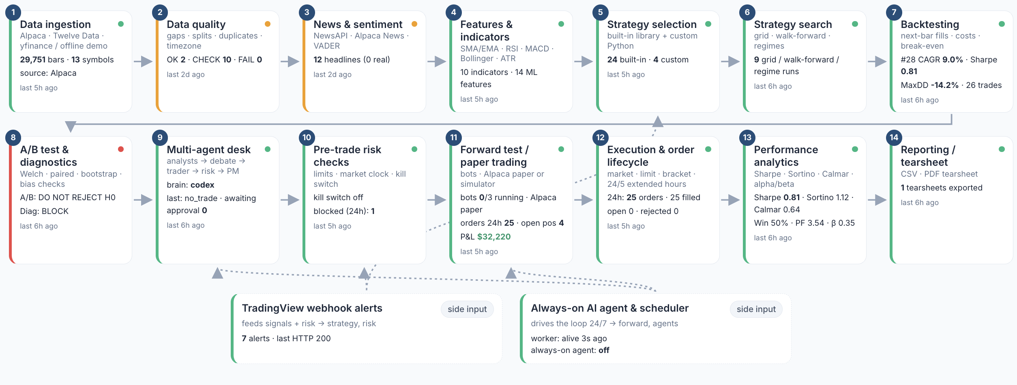
GETTING STARTED
The Trading Simulator — Pipeline Map
Pipeline Map shows the 14 stages of the automated pipeline, plus TradingView webhook alerts and the always-on AI agent as side inputs, each with its live state. Click a stage to see its activity.
AI Powered Quantitative Trading Fundamentals · C728 · v2.0
© Tertiary Infotech Academy Pte Ltd
18

Slide 19
GETTING STARTED
Sign Up for Alpaca and Open the Paper-Trading Account
Full step-by-step guide: Learner Guide, 'Platform Guides'.
1
2
3
4
5
▶
▶
▶
▶
Sign up at alpaca.markets and verify your email
Log in; choose 'Paper Trading' (upper left)
API section: generate key - copy the secret once
Simulator: Integrations > Alpaca > paste > Save & test
Test connection: 'Paper account ACTIVE'
No deposit needed. Paper keys only work on paper-api.alpaca.markets. No account? Every lab also runs offline.
AI Powered Quantitative Trading Fundamentals · C728 · v2.0
© Tertiary Infotech Academy Pte Ltd
19

Slide 20

GETTING STARTED
Your Alpaca Paper-Trading Dashboard
Check that the account selector shows 'Paper'. The banner confirms that no real money is being used. The API keys for the labs are generated from this account.
AI Powered Quantitative Trading Fundamentals · C728 · v2.0
© Tertiary Infotech Academy Pte Ltd
20

Slide 21

GETTING STARTED
Connect Alpaca to the Simulator — Integrations
Paste the paper Key ID and Secret into the Alpaca card, then press Save & test. Keys stay on your computer and are only shown masked. Without keys, every lab still runs offline.
AI Powered Quantitative Trading Fundamentals · C728 · v2.0
© Tertiary Infotech Academy Pte Ltd
21

Slide 22
GETTING STARTED
Sign Up for TradingView and Find the Tools You Will Use
Full step-by-step guide: Learner Guide, 'Platform Guides'.
1
2
3
4
5
▶
▶
▶
▶
Sign up at tradingview.com (email, Google or Apple)
Keep the free plan
Products > Supercharts; search NASDAQ:AAPL or SGX:D05
Set time zone to Singapore
Find Indicators, Pine Editor, Strategy Tester, Trade
The free plan covers Labs 2, 5 and 6. Webhook alerts in Lab 17 need a paid plan - the lab includes a local simulator.
AI Powered Quantitative Trading Fundamentals · C728 · v2.0
© Tertiary Infotech Academy Pte Ltd
22

Slide 23

GETTING STARTED
TradingView — Chart, Watchlist and Symbol Panel
Search for a symbol, pick the interval, and add Indicators. Pine Script and the Strategy Tester open from the panel below the chart, and Trade opens Paper Trading.
AI Powered Quantitative Trading Fundamentals · C728 · v2.0
© Tertiary Infotech Academy Pte Ltd
23

Slide 24
GETTING STARTED · LOW CODE
No Coding Needed - and a Prompt Library if You Want the Code
Every lab, no code
Want to see the code?
Run it without installing
Each lab runs in the Trading Simulator: choose settings, press Run, read the result. The lab manual gives every step and check.
labs/Prompt_Library.html has one prompt per lab. One click opens Claude or ChatGPT with the prompt filled in - the AI writes the code for you.
Paste the code into Google Colab and press Run, or paste a strategy into the simulator's Strategy Builder. Never paste API keys into an AI chat.
AI Powered Quantitative Trading Fundamentals · C728 · v2.0
© Tertiary Infotech Academy Pte Ltd
24

Slide 25
PLATFORM · THE IDEA THAT MATTERS MOST
Paper first. Always.
Every strategy in this course is tested on history, then forward-tested on a paper account with automatic orders, before anyone would consider real capital. That discipline is the course.
AI Powered Quantitative Trading Fundamentals · C728 · v2.0
© Tertiary Infotech Academy Pte Ltd
25

Slide 26
01
TOPIC 1
Quant and Algo Trading Foundations
LEARNING OUTCOME
Develop hypotheses for implementing data analytics and computational modelling activities in algorithmic trading, and identify possible big data applications across the forms of data within financial services.
Day 1 · Labs 1–4
AI Powered Quantitative Trading Fundamentals · C728 · v2.0
© Tertiary Infotech Academy Pte Ltd
26

Slide 27
TOPIC 1 · QUANT SUCCESS STORIES
Quant Success Stories
Ed Thorp - Princeton Newport · 1969
First market-neutral quant fund: about 20% a year after fees for two decades by hedging warrants and convertibles
Renaissance - Medallion · 1988
Purely model-driven; about 66% a year before fees, 39% after (1988-2018); closed to outsiders, employee-owned
1
2
D.E. Shaw · 1988
Founded by a computer-science professor from Morgan Stanley's quant group; models and software; about US$60-65bn
Man AHL · 1987
Systematic trend following from hand-typed price histories to momentum models across 800+ markets
3
4
Two Sigma · 2001
AI, machine learning and distributed computing applied to trading; about US$70bn under management
Jane Street · 2024
Quant market maker: about US$20.5bn net trading revenue; nearly a quarter of primary US ETF activity
5
6
AI Powered Quantitative Trading Fundamentals · C728 · v2.0
© Tertiary Infotech Academy Pte Ltd
27

Slide 28
TOPIC 1 · QUANT SUCCESS STORIES
Spotlight: Renaissance Technologies and the Medallion Fund
Founded by a mathematician
Jim Simons founds Monemetrics in 1978; renamed Renaissance Technologies in 1982
Medallion fund, 1988
The flagship fund trades purely on mathematical models of market data
1
2
About 66% a year before fees
Average gross return 1988-2018, about 39% after its high fees; closed to outsiders, employee-owned
The lesson for this course
The edge came from data, rigorous testing, costs and risk control - not from one clever indicator
3
4
AI Powered Quantitative Trading Fundamentals · C728 · v2.0
© Tertiary Infotech Academy Pte Ltd
28

Slide 29
TOPIC 1 · QUANT SUCCESS STORIES
What the Success Stories Have in Common
1
Hypothesis first
Each started from a testable idea about prices, not from a tool
2
Data and testing
Clean data and out-of-sample tests before capital
3
Many small edges
Diversified, market-neutral bets rather than one big call
4
Costs and risk
Execution cost, leverage and risk limits decide survival - see LTCM 1998
5
Citadel Securities
Quant market maker estimated to handle about a quarter of all US equities trading
AI Powered Quantitative Trading Fundamentals · C728 · v2.0
© Tertiary Infotech Academy Pte Ltd
29

Slide 30
TOPIC 1 · DEFINITION
Algorithmic trading
Using computer programs that follow predefined rules on price, timing, volume or models to generate and execute orders automatically, with limited or no human intervention.
AI Powered Quantitative Trading Fundamentals · C728 · v2.0
© Tertiary Infotech Academy Pte Ltd
30

Slide 31
TOPIC 1 · EVOLUTION OF QUANT
The Evolution of Quant: From Thorp to HFT to AI
1
2
3
4
5
6
7
▶
▶
▶
▶
▶
▶
1950s-70s: portfolio theory, arbitrage and option pricing
1970s-80s: factor risk models and program trading
1980s-90s: statistical arbitrage and pairs trading
1988 on: fully systematic signal mining (Renaissance, D.E. Shaw)
2000s: electronic market making and HFT
2010s: speed race - co-location, microwave, microseconds
2020s: ML on alternative data, then LLM and agentic quant
Each era kept the last era's discipline - hypothesis, data, testing, costs, risk - and added speed or new data.
AI Powered Quantitative Trading Fundamentals · C728 · v2.0
© Tertiary Infotech Academy Pte Ltd
31

Slide 32
TOPIC 1 · HISTORY OF QUANT
The Evolution of Quant and Algorithmic Trading (1 of 4)
1952
Modern portfolio theory
Markowitz's 'Portfolio Selection' measures risk as variance: diversification becomes maths
1969
First market-neutral quant fund
Thorp's fund (Princeton Newport from 1974) earns about 20% a year after fees for two decades
Mid-1970s
Factor risk models
Barr Rosenberg's Barra models portfolio risk from style, industry and size factors
1967
Thorp's 'Beat the Market'
Ed Thorp applies probability to hedging warrants - an early quant trading playbook
1973
Black-Scholes and the CBOE
Option-pricing formula published as the CBOE opens (Apr 1973); CBOE adopts it by 1975
1978
Renaissance is founded
Mathematician Jim Simons founds Monemetrics; renamed Renaissance Technologies in 1982
AI Powered Quantitative Trading Fundamentals · C728 · v2.0
© Tertiary Infotech Academy Pte Ltd
32

Slide 33
TOPIC 1 · HISTORY OF QUANT
The Evolution of Quant and Algorithmic Trading (2 of 4)
1980s
Statistical arbitrage
Bamberger and Tartaglia's Morgan Stanley group trades pairs of co-moving stocks by rule
1988
Medallion and D.E. Shaw
Renaissance launches Medallion; ex-Morgan Stanley quant David Shaw founds D.E. Shaw
1998
LTCM collapses
Leveraged relative-value fund loses US$4.6bn; Fed-supervised US$3.65bn recapitalisation
1987
Black Monday
Dow falls 22.6% on 19 Oct; portfolio-insurance program selling deepens the crash
1996
Island ECN
Fast electronic order book (trading from 1997) becomes a hub for early HFT firms
2001
Decimalisation
US stocks quote in cents, not 1/16ths; spreads narrow and electronic market making grows
AI Powered Quantitative Trading Fundamentals · C728 · v2.0
© Tertiary Infotech Academy Pte Ltd
33

Slide 34
TOPIC 1 · HISTORY OF QUANT
The Evolution of Quant and Algorithmic Trading (3 of 4)
2005
Regulation NMS
SEC rule (in force 2007) links venues; fragmentation rewards speed and smart order routing
2010
Flash Crash
6 May: the Dow drops nearly 1,000 points in minutes after a large algorithmic sell order
2012
Knight Capital
A faulty deployment sends millions of orders in 45 minutes; Knight loses over US$460m
2007
The quant quake
Week of 6 Aug: crowded quant market-neutral funds suffer sudden losses as positions unwind
2010
The speed race
US$300m straight fibre New York-Chicago cuts about 3 ms; microwave links soon beat it
2016
IEX speed bump
SEC approves IEX as an exchange with a 350-microsecond delay against latency arbitrage
AI Powered Quantitative Trading Fundamentals · C728 · v2.0
© Tertiary Infotech Academy Pte Ltd
34

Slide 35
TOPIC 1 · HISTORY OF QUANT
The Evolution of Quant and Algorithmic Trading (4 of 4)
2018
MiFID II
EU requires algorithm testing, kill switches and records; HFT formally defined
2020
SGX RegCo algo guide
Sets expectations for governance, risk controls and testing of algorithms by SGX members
2024
Multi-agent LLM trading
TradingAgents (Dec 2024): analyst, debate, trader and risk agents trade stocks
2018
API-first brokers
Alpaca's commission-free trading API opens algorithmic stock trading to individuals
2023
LLM trading signals
ChatGPT headline sentiment predicts next-day stock returns (Lopez-Lira and Tang)
2026
MAS AI Risk Management
Guidelines issued 7 Oct 2026, effective 7 Oct 2027: AI inventories and lifecycle controls
AI Powered Quantitative Trading Fundamentals · C728 · v2.0
© Tertiary Infotech Academy Pte Ltd
35

Slide 36
TOPIC 1 · PARADIGM SHIFTS
Six Paradigm Shifts in Quant and Algorithmic Trading
From intuition to probability · 1950s-1970s
Markowitz, Thorp and Black-Scholes make risk, hedging and option value mathematical
From stocks to factors · 1970s-1980s
Barra factor models and program trading treat portfolios as baskets of risk exposures
1
2
From factors to statistical arbitrage · 1980s-2000s
Morgan Stanley's pairs group, D.E. Shaw and Renaissance harvest many small market-neutral edges
From floors to electronic speed · 1996-2010s
ECNs, decimalisation and Reg NMS enable HFT: co-location, microwave links, microseconds
3
4
From statistics to machine learning · 2000s-2010s
Models learn non-linear patterns from prices, order books and alternative data
From writing code to directing AI · 2023-present
AI writes and runs the code; quants own the big concepts - hypothesis, algorithm logic, testing, risk
5
6
AI Powered Quantitative Trading Fundamentals · C728 · v2.0
© Tertiary Infotech Academy Pte Ltd
36

Slide 37
TOPIC 1
Why Algorithms - and What Can Go Wrong
Benefits
Risks
• Speed: reacts and executes in milliseconds
• Discipline: rules remove fear, greed and fatigue
• Backtesting: test ideas on historical data first
• Lower costs: split large orders to reduce market impact
• Scale: monitors many markets and assets around the clock
• Technical failure: bugs and outages (Knight Capital, 2012)
• Overfitting: great backtests that fail on live data
• Black swans and regime change the model has never seen
• Feedback loops between algorithms (2010 Flash Crash)
• Set-up, data and compliance costs; no guaranteed profit
AI Powered Quantitative Trading Fundamentals · C728 · v2.0
© Tertiary Infotech Academy Pte Ltd
37

Slide 38
TOPIC 1 · AI IN TRADING
The Eras of AI in Trading
1
Symbolic AI · 1956-1980s
Hand-written rules: expert systems and rule-based program trading; brittle when markets change
2
Machine learning · 1990s-2000s
Models learn from data: regression, tree and boosting signals; statistical arbitrage at scale
3
Deep learning · 2012-2017
Many-layer networks on GPUs find non-linear patterns in prices, order books and alternative data
4
Generative AI · 2017-2023
Transformers and LLMs turn news, filings and earnings calls into trading signals
5
Agentic AI · 2024-present
LLM agents research, code, backtest and paper-trade strategies under hard risk limits
AI Powered Quantitative Trading Fundamentals · C728 · v2.0
© Tertiary Infotech Academy Pte Ltd
38

Slide 39
TOPIC 1 · AI IN TRADING
AI Milestones and Their Trading Counterparts (1 of 2)
1950
Turing Test
Turing asks if machines can think; in 1952 Markowitz turns portfolio choice into maths
1980s
Expert systems
Hand-written if-then rules - the same logic as the rule-based program trading of the 1980s
1988
Models trade markets
Renaissance's Medallion fund launches, trading purely on mathematical models of market data
2012
Deep learning
GPU-trained deep networks win ImageNet; deep learning becomes a new tool for market data
1956
'AI' is named
AI becomes a field; Ed Thorp soon applies computers and probability to blackjack, then markets
1986
Backpropagation
Multi-layer neural networks become trainable - the ancestor of today's price-prediction nets
1997
Deep Blue
IBM beats Kasparov at chess; computer-driven quant firms such as D.E. Shaw are already trading
AI Powered Quantitative Trading Fundamentals · C728 · v2.0
© Tertiary Infotech Academy Pte Ltd
39

Slide 40
TOPIC 1 · AI IN TRADING
AI Milestones and Their Trading Counterparts (2 of 2)
2016
AlphaGo
Deep reinforcement learning wins at Go; RL is researched for order execution and portfolios
2023
LLMs meet markets
BloombergGPT (50bn parameters); ChatGPT headline sentiment predicts next-day stock returns
2025
Agentic quant research
LLM agents mine formulaic alphas and write backtests (e.g. Alpha-GPT, AlphaAgent)
2026
Governed AI
MAS AI Risk Management Guidelines (7 Oct 2026) set lifecycle controls for AI in finance
2017
Transformer
The architecture behind every LLM - later used to read news and filings for trading signals
2024
Multi-agent trading
TradingAgents models a trading firm: analyst, bull/bear debate, trader and risk agents
2026
Always-on AI agents
OpenClaw, Hermes Agent and OpenAI Dots stand by 24/7: agentic AI that keeps working
AI Powered Quantitative Trading Fundamentals · C728 · v2.0
© Tertiary Infotech Academy Pte Ltd
40

Slide 41
TOPIC 1 · ML TO LLM
Paradigm Shift: Machine-Learning Quant versus LLM-Era Quant
Machine-learning quant
LLM-era quant
Main data
Structured: prices, volumes, fundamentals
Adds unstructured text: news, filings, earnings calls, research
Features
Hand-engineered by the quant (lags, RSI, factors)
Text read directly; LLM scores sentiment and events
Model building
Fit regressions, trees, boosting on labelled data
Prompt or fine-tune pretrained LLMs; agents propose alphas
Who writes the code
The quant, line by line
AI writes it; the quant directs and reviews
Research workflow
The quant writes every line of code
Coding agents draft code and backtests; the quant reviews
Alpha decay
Signals fade as more funds trade them
LLM signals fade too as LLM adoption rises
New risks
Overfitting; look-ahead in features
LLM training-data look-ahead and 'distraction'; homogeneous factors
Human role
Model builder
Supervisor: hypothesis, testing, risk sign-off
AI Powered Quantitative Trading Fundamentals · C728 · v2.0
© Tertiary Infotech Academy Pte Ltd
41

Slide 42
TOPIC 1 · ML TO LLM
Impact of LLMs on Quant
Text becomes a signal
ChatGPT headline scores predict next-day returns, strongest for small stocks and bad news (Lopez-Lira and Tang)
Finance-specific LLMs
BloombergGPT (2023): 50bn parameters trained with 363bn tokens of Bloomberg financial data
1
2
Automated alpha mining
Alpha-GPT turns ideas into formulaic alphas; AlphaAgent targets alpha decay and crowding
Backtests need new controls
LLMs may 'know' in-sample history: test after the knowledge cutoff and anonymise firms (Glasserman and Lin)
3
4
Faster crowding
Strategy returns decline as LLM adoption rises - prices become more efficient (Lopez-Lira and Tang)
Agents still need limits
Agents propose trades; hard-coded risk checks and humans approve them
5
6
AI Powered Quantitative Trading Fundamentals · C728 · v2.0
© Tertiary Infotech Academy Pte Ltd
42

Slide 43
TOPIC 1 · AGENTIC AI
Agentic AI versus AI Agents in Trading
Agentic AI - the capability
AI Agent - always on, 24/7
The capability of AI to plan and act: it calls tools, uses skills and memory, and follows instructions to complete multi-step work when it is asked.
Trading example: On request, an LLM fetches a stock's bars and news through tools, checks its memory of past trades and proposes an order within its instructions
A special class of agentic AI that stands by 24/7 and works all the time: always on, woken by schedules, events and messages, with its own long-term memory.
Examples: OpenClaw, Hermes Agent, OpenAI Dots.
Trading example: A round-the-clock trading agent that watches prices and news overnight and proposes paper trades within risk limits
AI Powered Quantitative Trading Fundamentals · C728 · v2.0
© Tertiary Infotech Academy Pte Ltd
43

Slide 44
TOPIC 1 · AGENTIC AI
AI Agents vs Agentic AI - Side by Side
AI Agents
Agentic AI
What it is
A special class of agentic AI that is always on
Capability to plan and act with tools, skills, memory
Runtime
Persistent: stands by 24/7 on a server or PC
Runs when invoked: a chat, workflow or pipeline
Trigger
Schedules, events, messages - unprompted
A user prompt or a pipeline step
Memory
Long-term memory across days and tasks
Session or task memory; can use long-term memory
Building blocks
Agentic AI + always-on runtime and scheduler
LLM + tools + skills + memory + instructions
Examples
OpenClaw, Hermes Agent, OpenAI Dots
Claude Code, ChatGPT with tools, TradingAgents
Trading example
24/7 market and news monitor proposing trades
On-demand multi-agent analysis before a trade
Main risks
Acting unsupervised overnight; runaway loops
Hallucination; prompt injection; tool misuse
AI Powered Quantitative Trading Fundamentals · C728 · v2.0
© Tertiary Infotech Academy Pte Ltd
44

Slide 45
TOPIC 1 · AGENTIC AI
From Chatbot to Always-On AI Agent
1
2
3
4
▶
▶
▶
1 · Chatbot: Answers one prompt at a time; no tools, no actions
2 · Agentic AI: Plans and calls tools, skills, memory and instructions when asked
3 · Multi-agent agentic system: Specialist agents coordinate: analysts, debate, trader, risk manager
4 · AI agent (always on): Stands by 24/7, wakes on schedules and events, works continuously within limits
An AI agent is agentic AI that never switches off - so its limits, kill switch and monitoring matter most.
AI Powered Quantitative Trading Fundamentals · C728 · v2.0
© Tertiary Infotech Academy Pte Ltd
45

Slide 46
TOPIC 1 · MULTI-AGENT TRADING
Roles in a Multi-Agent Trading System
1
Fundamental Analyst
Reads filings, earnings and balance sheets to judge intrinsic value
2
Technical Analyst
Reads price, volume and indicators such as MACD and RSI
3
Sentiment Analyst
Gauges mood from social media, analyst ratings and options flow
4
News Analyst
Tracks news wires, press releases and macro events
5
Bull / Bear Researchers
Argue for and against the trade so weak ideas are challenged
6
Trader
Combines the reports into a buy, sell or hold call with timing and size
7
Risk Manager
Checks volatility, liquidity, exposure and drawdown limits
8
Portfolio Manager
Approves or rejects the proposal and fits it into the whole portfolio
AI Powered Quantitative Trading Fundamentals · C728 · v2.0
© Tertiary Infotech Academy Pte Ltd
46

Slide 47
TOPIC 1 · MULTI-AGENT TRADING
Stock-Trading Agent Frameworks (1 of 2)
1
TradingAgents (Xiao et al., 2024)
Simulated stock-trading firm: fundamental, sentiment, news and technical analysts, bull/bear debate, trader, risk team
2
FinMem (Yu et al., 2023)
LLM trading agent with profiling and layered memory making Buy / Sell / Hold decisions on individual stocks
3
FinAgent (Zhang et al., 2024)
Multimodal agent reading prices, news and chart images, with dual-level reflection; tested on stocks and crypto
4
StockAgent (2024)
LLM investor agents trade a simulated stock market under macro, policy and event shocks; avoids test-set leakage
AI Powered Quantitative Trading Fundamentals · C728 · v2.0
© Tertiary Infotech Academy Pte Ltd
47

Slide 48
TOPIC 1 · MULTI-AGENT TRADING
Stock-Trading Agent Frameworks (2 of 2)
QuantAgent (2025)
Price-driven multi-agent system for high-frequency trading: Indicator, Pattern, Trend and Risk agents
1
AI Hedge Fund (open source)
Investor-persona agents (e.g. Warren Buffett), a risk manager and a portfolio manager decide trades for chosen tickers
2
Agentic Trading Lab (Open-Finance-Lab)
Agent-run stock portfolios with backtests and paper trading through the Alpaca API
3
AI Powered Quantitative Trading Fundamentals · C728 · v2.0
© Tertiary Infotech Academy Pte Ltd
48

Slide 49
TOPIC 1 · GOVERNANCE
Risks and Controls for AI Agents in Trading
What goes wrong
Control
Hallucination
An LLM states a wrong earnings figure or invents a signal with confidence
Ground answers in tool or RAG data, log the reasoning, review unusual calls
Prompt injection
Malicious text in news, web pages or files hijacks the agent's instructions
Input and output guardrails, least-privilege API keys, no secrets in prompts
Overtrading and runaway loops
Agents trade too often or amplify each other, compounding losses
Order and position caps, daily-loss circuit breaker, kill switch
Model and backtest risk
Overfitting, look-ahead bias and regime change: strong backtests, weak live results
Walk-forward tests, paper trade first, monitor drift and costs
Accountability
Unclear who answers for an autonomous agent's trade or a vendor's AI
The firm stays accountable: human sign-off, audit trails, clear owners
Regulation (MAS)
FEAT principles (2018) and MAS AI Risk Management Guidelines (issued Oct 2026)
Board oversight, AI inventory, materiality assessment and lifecycle controls
AI Powered Quantitative Trading Fundamentals · C728 · v2.0
© Tertiary Infotech Academy Pte Ltd
49

Slide 50
TOPIC 1
Forms of Data within Financial Services
Market data
OHLCV bars, quotes, trades, order-book depth — Alpaca serves bars, quotes, trades, news.
Reference & corporate actions
Symbols, calendars, splits, dividends — unadjusted splits fake a crash.
1
2
Fundamental & macro
Statements, ratios, earnings; rates, inflation, central-bank decisions.
Alternative data
News and social sentiment, web traffic, satellite, card spend, ESG.
3
4
AI Powered Quantitative Trading Fundamentals · C728 · v2.0
© Tertiary Infotech Academy Pte Ltd
50

Slide 51

TOPIC 1
Unstructured Data in Practice — Headlines and Sentiment
Data > News & sentiment: headlines (unstructured text) are scored by a lexicon model and stored as one sentiment number per symbol per day - structured data a strategy can use.
AI Powered Quantitative Trading Fundamentals · C728 · v2.0
© Tertiary Infotech Academy Pte Ltd
51

Slide 52
TOPIC 1
Big Data in Trading — the Four Vs
Volume
Tick data runs to billions of rows per year for one exchange.
Velocity
Streaming quotes and news arrive in milliseconds.
1
2
Variety
Prices, text, images, transcripts — structured and unstructured.
Veracity
Bad ticks, survivorship, restatements — verify before you trust.
3
4
AI Powered Quantitative Trading Fundamentals · C728 · v2.0
© Tertiary Infotech Academy Pte Ltd
52

Slide 53
TOPIC 1
Big Data Applications
Execution analytics
Tick and quote data to measure and cut slippage.
Sentiment and event trading
News and social text scored by NLP and LLMs.
1
2
Regime detection
Cross-asset returns clustered into market states.
Surveillance and risk
Order and trade data scanned for market abuse; intraday risk.
3
4
AI Powered Quantitative Trading Fundamentals · C728 · v2.0
© Tertiary Infotech Academy Pte Ltd
53

Slide 54
TOPIC 1
Data Analytics and Modelling Use Cases
Signal generation
Find repeatable return — judged by out-of-sample, net Sharpe.
Execution
VWAP / TWAP / shortfall — judged by slippage in basis points.
1
2
Risk forecasting & sizing
Volatility and VaR models — judged by limit breaches.
Research at scale
LLMs read filings and news — judged by accuracy and hours saved.
3
4
AI Powered Quantitative Trading Fundamentals · C728 · v2.0
© Tertiary Infotech Academy Pte Ltd
54

Slide 55
TOPIC 1
What Makes a Hypothesis Testable
Instrument and universe
e.g. SPY, daily bars, 2018 – 2025.
Signal and holding period
e.g. three down closes in a row; hold 5 days.
1
2
Expected effect and benchmark
Forward return exceeds the unconditional 5-day return.
Written BEFORE the test
H0, H1 and the significance level chosen first.
3
4
AI Powered Quantitative Trading Fundamentals · C728 · v2.0
© Tertiary Infotech Academy Pte Ltd
55

Slide 56

TOPIC 1
A Testable Hypothesis in Practice
Research > Hypothesis test: H1 and H0 are written before the result, then tested with a Welch t-test, a bootstrap confidence interval and a minimum edge (Lab 4).
AI Powered Quantitative Trading Fundamentals · C728 · v2.0
© Tertiary Infotech Academy Pte Ltd
56

Slide 57
TOPIC 1
Machine Learning Implementation Steps
1
2
3
4
5
6
▶
▶
▶
▶
▶
Frame the problem and hypothesis
Collect and clean the data
Define target and features
Split by time; train and validate
Test out of sample
Paper trade, then review
A model that skips the out-of-sample test and the paper trade has not been tested.
AI Powered Quantitative Trading Fundamentals · C728 · v2.0
© Tertiary Infotech Academy Pte Ltd
57

Slide 58
TOPIC 1 · HANDS-ON LAB
Pipeline Skeleton, Configuration and the Alpaca Paper Account
LAB 01
Get the simulator running, decide between the offline demo and an Alpaca paper account, and check every integration's status.
WORKFLOW
1
2
3
4
5
Simulator: Load the demo data
▶
Simulator: Check the integrations
▶
Simulator: Check the AI agent login
▶
Simulator: Read the market clock
▶
Simulator: Tour the Pipeline Map
YOU'LL PRODUCE
Duration
20 min
A working app with demo data loaded, a verified Alpaca paper account or the simulator, and a known AI-agent brain.
AI Powered Quantitative Trading Fundamentals · C728 · v2.0
© Tertiary Infotech Academy Pte Ltd
58

Slide 59
LAB 01 · FOLLOW ALONG
Lab 01 — Step by Step
Course Labs > Lab 01 at http://localhost:8000 - each step's Go button opens its page pre-filled. Tick each 'You should see' before moving on.
STEP · WHERE
DO THIS
YOU SHOULD SEE
Load the demo data
▸ Settings > Demo data
Open Settings and press 'Load / refresh demo data'.
✓ Settings shows about 29,000 bars and at least 8 backtests.
1
Check the integrations
▸ Integrations
Open Integrations. Without keys, Alpaca shows 'not configured' and the app uses the simulator broker and the offline data.
✓ Alpaca test says 'Paper account ACTIVE' (online) - or you understand the app runs fully offline.
2
Check the AI agent login
▸ Integrations > AI providers
On the Integrations page read the OpenAI Codex and Claude cards.
✓ You can say which brain the desk will use: codex, claude, openai or the rule-based fallback.
3
Read the market clock
▸ Paper Trading > clock
Look at the US session badge in the top bar.
✓ You can explain why orders placed during class become extended-hours LIMIT orders.
4
Tour the Pipeline Map
▸ Pipeline Map
Open the Pipeline Map and hover each of the 14 stages. Click 'Data ingestion' to see its recent activity.
✓ Data ingestion and Backtesting are green; you can name the stage that enforces the kill switch.
5
AI Powered Quantitative Trading Fundamentals · C728 · v2.0
© Tertiary Infotech Academy Pte Ltd
59

Slide 60
LAB 01 · SIMULATOR
Lab 01 — How to Read the Screen
No keys needed
Every lab runs on the offline demo data and the built-in paper broker; keys are optional.
5
1
1
Paste your Alpaca keys
Key ID (starts with PK) and Secret from Alpaca > Paper account > API Keys.
2
4
Save & test
Green 'Paper account ACTIVE' = connected. paper=True is hard-coded: no live trading.
2
3
Optional data sources
Twelve Data and the other cards are extras; 'connected' shows the key works.
4
3
Status bar
US session and clock, broker (Alpaca paper or Offline demo), AI brain and the kill switch.
5
Ready when the status bar shows your broker and every lab page opens - online with Alpaca paper or fully offline.
AI Powered Quantitative Trading Fundamentals · C728 · v2.0
© Tertiary Infotech Academy Pte Ltd
60

Slide 61
TOPIC 1 · HANDS-ON LAB
Data-Validation Stage: Cross-Check Pipeline Bars against TradingView
LAB 02
Prove the app's prices are right: compare its bars with TradingView's Data Window and explain adjusted vs unadjusted prices.
WORKFLOW
1
2
3
4
Simulator: Read TradingView's Data Window
▶
Simulator: Compare with RAW and ADJUSTED bars
▶
Simulator: Repeat for SGX:D05 (DBS)
▶
Simulator: Inspect the chart
YOU'LL PRODUCE
Duration
20 min
A PASS / FAIL validation for SGX:D05 and NASDAQ:AAPL on 2025-12-31, with the dividend-adjustment factor explained.
AI Powered Quantitative Trading Fundamentals · C728 · v2.0
© Tertiary Infotech Academy Pte Ltd
61

Slide 62
LAB 02 · FOLLOW ALONG
Lab 02 — Step by Step
Course Labs > Lab 02 at http://localhost:8000 - each step's Go button opens its page pre-filled. Tick each 'You should see' before moving on.
STEP · WHERE
DO THIS
YOU SHOULD SEE
Read TradingView's Data Window
▸ Data > Validate vs TradingView (AAPL)
In TradingView open NASDAQ:AAPL, daily timeframe, hover the bar of 2025-12-31 and read open/high/low/close in the Data Window (default settings: dividends NOT adjusted).
✓ You have four numbers from TradingView.
1
Compare with RAW and ADJUSTED bars
▸ Data > Validate vs TradingView
Type your TradingView values into the 'Your TradingView reading' row. The app shows the difference against RAW (split-adjusted only) and ADJUSTED (split + dividend) bars.
✓ Verdict 'PASS - TradingView matches RAW' (to within 0.1%).
2
Repeat for SGX:D05 (DBS)
▸ Data > Validate vs TradingView (D05)
Select SGX:D05. DBS pays large dividends, so the adjustment factor is far from 1.
✓ You can explain why the ADJUSTED close is lower than the RAW close and why a model trained on adjusted prices must never be fed raw live prices.
3
Inspect the chart
▸ Data > Chart AAPL
Open the AAPL chart and compare its shape with TradingView.
✓ The candles match TradingView's daily chart (allowing for the adjustment).
4
AI Powered Quantitative Trading Fundamentals · C728 · v2.0
© Tertiary Infotech Academy Pte Ltd
62

Slide 63
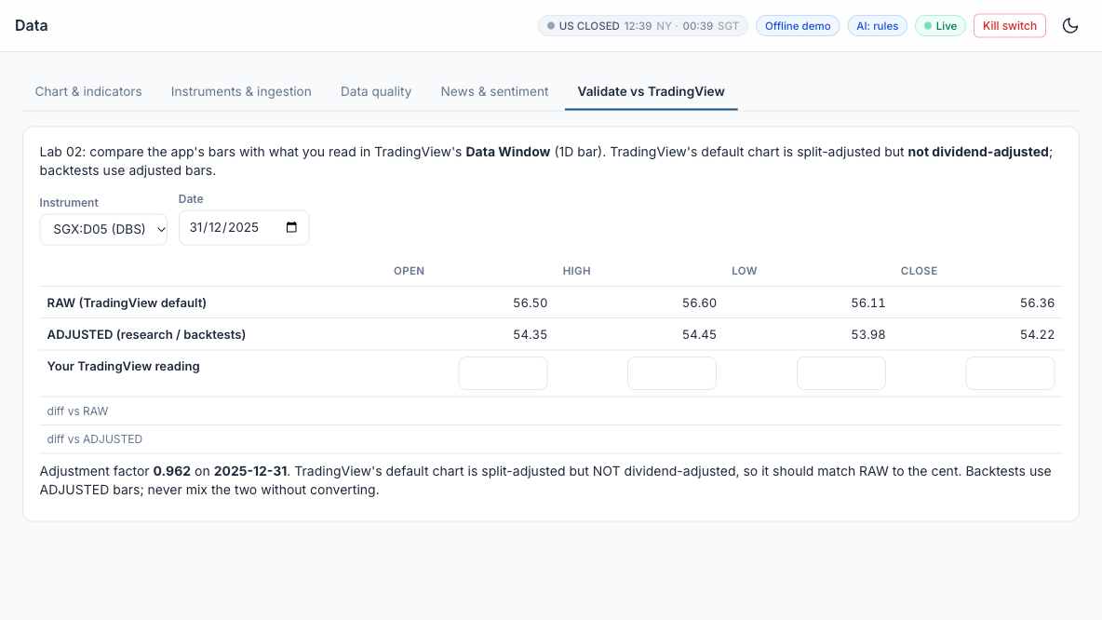
LAB 02 · SIMULATOR
Lab 02 — How to Read the Screen
Instrument and date
SGX:D05 (DBS) or NASDAQ:AAPL on 31/12/2025 - the bar you read in TradingView.
1
RAW bars
Split-adjusted only, the TradingView default. Your reading should match this row.
1
2
2
ADJUSTED bars
Split + dividend adjusted, used by research and backtests - lower than RAW for DBS.
3
3
4
Your TradingView reading
Type the four prices; the diff rows show the gap. Within 0.1% of RAW = PASS.
4
5
Adjustment factor
0.962 for DBS: dividends shrink its history by about 4%.
5
PASS when TradingView matches RAW. Never feed raw live prices to a model trained on adjusted prices.
AI Powered Quantitative Trading Fundamentals · C728 · v2.0
© Tertiary Infotech Academy Pte Ltd
63

Slide 64
TOPIC 1 · HANDS-ON LAB
Ingestion Stage: Multi-Timeframe Bars, Headlines and Data Quality
LAB 03
Ingest bars from Alpaca / Twelve Data / yfinance (or the demo files), run the data-quality checks and score news sentiment.
WORKFLOW
1
2
3
4
Simulator: Fetch data
▶
Simulator: Read the data-quality report
▶
Simulator: Switch timeframes
▶
Simulator: Headlines and sentiment
YOU'LL PRODUCE
Duration
20 min
A cached universe, a data-quality report and scored headlines with daily sentiment.
AI Powered Quantitative Trading Fundamentals · C728 · v2.0
© Tertiary Infotech Academy Pte Ltd
64

Slide 65
LAB 03 · FOLLOW ALONG
Lab 03 — Step by Step
Course Labs > Lab 03 at http://localhost:8000 - each step's Go button opens its page pre-filled. Tick each 'You should see' before moving on.
STEP · WHERE
DO THIS
YOU SHOULD SEE
Fetch data
▸ Data > Fetch AAPL
Data > Instruments & ingestion: fetch AAPL with source 'auto' (Alpaca if keys, else the demo file). Online, try 'yfinance' or 'Twelve Data' too (Twelve Data needs TWELVEDATA_API_KEY).
✓ A toast reports the number of bars, the source and the quality status.
1
Read the data-quality report
▸ Data > Quality SPY
Open Data quality for SPY. Look at missing values, duplicate timestamps, gaps over 4 days and big moves (possible unadjusted splits).
✓ Status OK or CHECK; the big-move dates include March 2020.
2
Switch timeframes
▸ Data > Chart SPY weekly
On the chart, switch SPY between 1Day, 1Week, 1Month and 1Hour.
✓ Weekly and monthly bars are resampled from daily bars; hourly bars are US/Eastern.
3
Headlines and sentiment
▸ Data > News NVDA
Data > News & sentiment for NVDA: press 'Fetch & score headlines'. Online with NEWSAPI_KEY it calls NewsAPI.org. otherwise Alpaca News or the synthetic sample headlines.
✓ Each headline has a VADER score between -1 and +1; the daily sentiment chart appears.
4
AI Powered Quantitative Trading Fundamentals · C728 · v2.0
© Tertiary Infotech Academy Pte Ltd
65

Slide 66
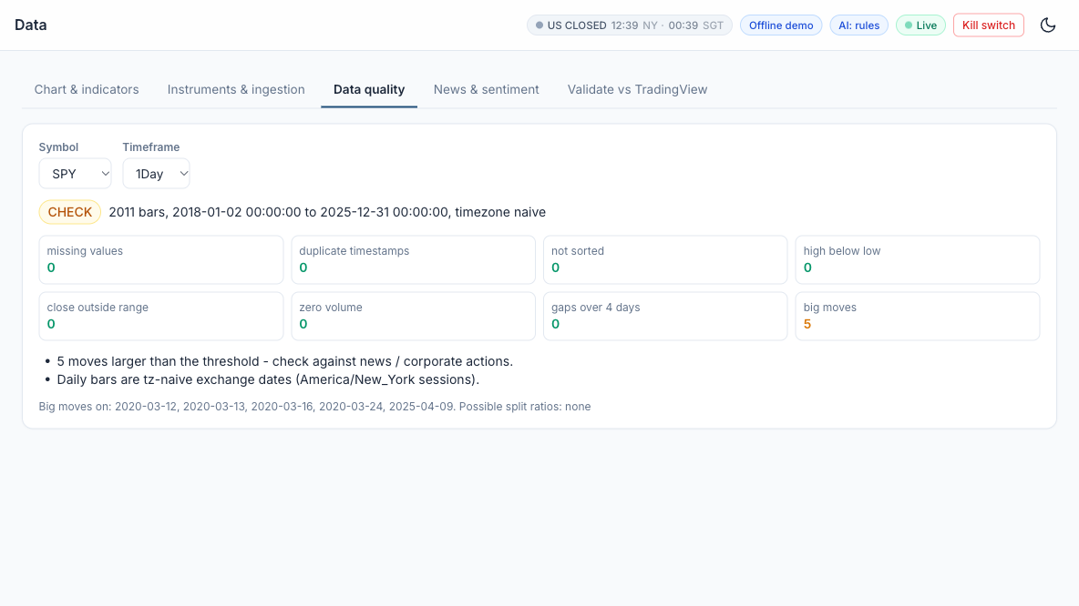
LAB 03 · SIMULATOR
Lab 03 — How to Read the Screen
Symbol and timeframe
SPY, 1Day. Weekly and monthly bars are resampled from the daily bars.
1
1
Overall status
CHECK: 2,011 bars, 2018-01-02 to 2025-12-31 - usable, but something needs a look.
2
2
3
4
Seven integrity checks
Missing, duplicate, unsorted, high < low, close outside range, zero volume, gaps: all 0.
3
5
Big moves: 5
Days beyond the threshold - real news, or an unadjusted split?
4
Explain each big move
March 2020 (COVID crash) and 2025-04-09 (tariff-pause rally); no split ratios found.
5
CHECK is not FAIL: every flagged date has a real-world cause, so the data are fit for research.
AI Powered Quantitative Trading Fundamentals · C728 · v2.0
© Tertiary Infotech Academy Pte Ltd
66

Slide 67
Lunch Break
1 hour · see you at 13:30
AI Powered Quantitative Trading Fundamentals · C728 · v2.0
© Tertiary Infotech Academy Pte Ltd
67

Slide 68
TOPIC 1 · HANDS-ON LAB
Hypothesis Stage: from a Written Card to an Automated Statistical Test
LAB 04
Write H0 and H1 before looking at results and test them with a Welch t-test and a bootstrap CI.
WORKFLOW
1
2
3
Simulator: Write the hypothesis card
▶
Simulator: Run the test
▶
Simulator: Robustness and multiple testing
YOU'LL PRODUCE
Duration
15 min
A decision (SUPPORTED / NOT SUPPORTED) with p-value, edge in bps and a robustness grid.
AI Powered Quantitative Trading Fundamentals · C728 · v2.0
© Tertiary Infotech Academy Pte Ltd
68

Slide 69
LAB 04 · FOLLOW ALONG
Lab 04 — Step by Step
Course Labs > Lab 04 at http://localhost:8000 - each step's Go button opens its page pre-filled. Tick each 'You should see' before moving on.
STEP · WHERE
DO THIS
YOU SHOULD SEE
Write the hypothesis card
▸ Research > Hypothesis (SPY, losing streak 3)
Research > Hypothesis test. Keep signal 'losing streak' n = 3, horizon 1 day, alpha 0.05, min edge 3 bps. Read the H1 and H0 text.
✓ H0 and H1 are written before you press Run.
1
Run the test
▸ Research > Hypothesis test
Press 'Run the test'.
✓ You can read the signal-day mean, the other-day mean, Welch t and p, and the 95% bootstrap CI.
2
Robustness and multiple testing
▸ same page
Read the robustness grid (other streak lengths and QQQ) and the Bonferroni alpha.
✓ You can explain why trying many variants inflates false positives.
3
AI Powered Quantitative Trading Fundamentals · C728 · v2.0
© Tertiary Infotech Academy Pte Ltd
69

Slide 70
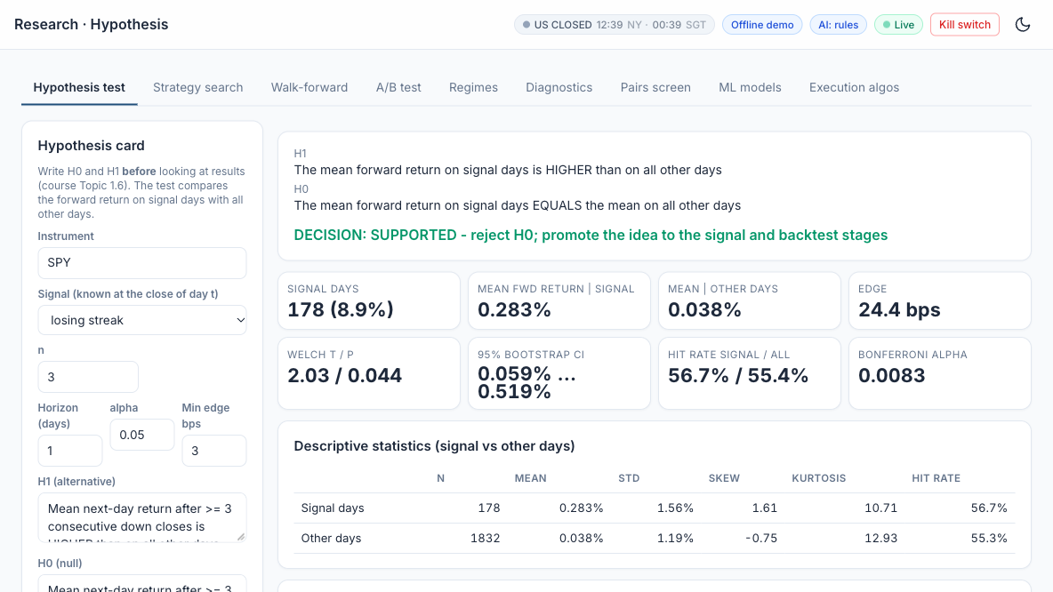
LAB 04 · SIMULATOR
Lab 04 — How to Read the Screen
Hypothesis card
SPY, losing streak n = 3, 1-day horizon, alpha 0.05, min edge 3 bps. Write H0 and H1 first.
1
1
2
H1, H0 and the decision
SUPPORTED - reject H0: signal days beat the other days.
2
3
The edge
178 signal days return 0.283% vs 0.038%: a 24.4 bps edge, above the 3 bps minimum.
3
4
Is it real?
Welch p 0.044 < 0.05 and the bootstrap CI excludes 0. Stricter bar: Bonferroni alpha 0.0083.
5
4
Descriptive statistics
Signal days are more volatile (1.56% std) and skewed - one reason to bootstrap.
5
Passes at alpha 0.05 but not at the Bonferroni 0.0083: promote it as a candidate and keep testing (Labs 10, 13, 18).
AI Powered Quantitative Trading Fundamentals · C728 · v2.0
© Tertiary Infotech Academy Pte Ltd
70

Slide 71
TOPIC 1 · WHAT YOU COVERED
Topic 1 Recap
1
Develop hypotheses for implementing data analytics and computational modelling activities
2
Identify possible big data applications
3
Data analytics and modelling business use cases
4
Forms of data within financial services
AI Powered Quantitative Trading Fundamentals · C728 · v2.0
© Tertiary Infotech Academy Pte Ltd
71

Slide 72
02
TOPIC 2
Indicators, Strategies and Metrics
LEARNING OUTCOME
Identify appropriate statistical algorithms and data models to test trading hypotheses, and use appropriate analytics platforms, analytical tools and statistical methods given specific analytics and reporting requirements.
Day 1 · Labs 5–9
AI Powered Quantitative Trading Fundamentals · C728 · v2.0
© Tertiary Infotech Academy Pte Ltd
72

Slide 73
TOPIC 2
Trend and Momentum Indicators
SMA / EMA
Average close over n bars; EMA weights recent bars by 2/(n+1).
MACD
EMA12 − EMA26 with a 9-EMA signal line; crosses flag momentum.
1
2
RSI (14)
100 − 100/(1+RS); above 70 overbought, below 30 oversold.
Donchian channel
Highest high / lowest low of n bars — the breakout level.
3
4
AI Powered Quantitative Trading Fundamentals · C728 · v2.0
© Tertiary Infotech Academy Pte Ltd
73

Slide 74

TOPIC 2 · INDICATOR
Indicator: Moving Averages (SMA and EMA)
DEFINITION
The average closing price over the last n bars - a smoothed line that shows the trend. The EMA weights recent bars more, so it turns sooner.
FORMULA
SMA(n) = (C1 + C2 + ... + Cn) / n. EMA(t) = a x C(t) + (1 - a) x EMA(t-1), with a = 2 / (n + 1).
HOW TO READ IT
Price above a rising average = uptrend. The 50 / 200-day pair is the classic trend filter; EMA 20 tracks the short-term trend.
INSIGHT
Every average lags: the longer n, the smoother - and the later each signal. In sideways markets price whipsaws across it.
AI Powered Quantitative Trading Fundamentals · C728 · v2.0
© Tertiary Infotech Academy Pte Ltd
74

Slide 75

TOPIC 2 · INDICATOR
Indicator: MACD (Moving Average Convergence Divergence)
DEFINITION
A momentum-of-trend gauge: the gap between a fast and a slow EMA, with a signal line and a histogram that show whether momentum is growing.
FORMULA
MACD = EMA12(C) - EMA26(C). Signal = EMA9(MACD). Histogram = MACD - Signal.
HOW TO READ IT
MACD crossing above its signal line = momentum turning up; MACD above zero = the 12-day trend is above the 26-day trend.
INSIGHT
A shrinking histogram warns that a move is losing strength before price turns - but it is built from EMAs, so it lags and whipsaws in ranges.
AI Powered Quantitative Trading Fundamentals · C728 · v2.0
© Tertiary Infotech Academy Pte Ltd
75

Slide 76

TOPIC 2 · INDICATOR
Indicator: RSI (Relative Strength Index)
DEFINITION
An oscillator from 0 to 100 that compares the size of recent gains with recent losses - how stretched the latest move is.
FORMULA
RS = average gain / average loss over n bars (Wilder smoothing, n = 14). RSI = 100 - 100 / (1 + RS).
HOW TO READ IT
Above 70 = overbought, below 30 = oversold. Short look-backs such as RSI(2) are used for mean-reversion entries.
INSIGHT
In a strong trend RSI can stay above 70 for weeks: overbought is not a sell signal by itself. Test the thresholds - they are conventions.
AI Powered Quantitative Trading Fundamentals · C728 · v2.0
© Tertiary Infotech Academy Pte Ltd
76

Slide 77
TOPIC 2 · INDICATOR
RSI(N): the Number Is the Look-back Period
RSI(2) - short look-back
RSI(14) - Wilder's standard (1978)
Look-back
The last 2 bars (days on a daily chart)
The last 14 bars - about 3 trading weeks
Reacts to
1-2 day moves: fast and jumpy
Sustained moves: smooth and slower
How often extreme
Often: SPY RSI(2) < 10 on 9.6% of days
Rarely: SPY RSI(14) < 30 on 1.7% of days
Typical levels
Buy below 10, exit above 70 (simulator default)
Buy below 30, sell above 70
SPY, 10 Oct 2025 (-2.7% after a -0.3% day)
5.8 - deeply oversold: the RSI(2) rule buys
42.5 - neutral: no signal
Next trading day, 13 Oct
SPY +1.5% - the bounce is captured
No trade
Simulator strategy
RSI(2) mean reversion (Connors style)
RSI oversold / overbought
AI Powered Quantitative Trading Fundamentals · C728 · v2.0
© Tertiary Infotech Academy Pte Ltd
77

Slide 78
TOPIC 2 · INDICATOR
The Number in Brackets Is Always the Look-back
RSI(N) formula
RS = average gain / average loss over the last N bars; RSI = 100 - 100 / (1 + RS). Mostly up days: near 100. Mostly down: near 0. Equal: 50.
SMA(50) and EMA(20)
SMA(50): average of the last 50 closes. EMA(20): exponential average over about 20 bars, weighting recent bars more.
1
2
Bollinger(20, 2) and ATR(14)
Bollinger: 20-day average with bands 2 standard deviations away. ATR(14): average true range over 14 bars.
Where to change N
TradingView: the indicator's Settings > Inputs > Length. Simulator: the strategy's parameter (e.g. RSI length n) before you backtest.
3
4
AI Powered Quantitative Trading Fundamentals · C728 · v2.0
© Tertiary Infotech Academy Pte Ltd
78

Slide 79

TOPIC 2 · INDICATOR
Indicator: Donchian Channel
DEFINITION
A channel drawn through the highest high and the lowest low of the last n bars - the levels a breakout must clear.
FORMULA
Upper(n) = max(High, last n bars). Lower(n) = min(Low, last n bars). Classic n = 20 (the Turtle traders used 20 and 55).
HOW TO READ IT
A close above the prior upper band = upside breakout; exit on a break of a shorter (e.g. 10-day) low.
INSIGHT
Breakout systems win rarely but big. Compare today's close with the channel up to YESTERDAY - including today's high is look-ahead.
AI Powered Quantitative Trading Fundamentals · C728 · v2.0
© Tertiary Infotech Academy Pte Ltd
79

Slide 80
TOPIC 2
Volatility and Volume Indicators
Bollinger Bands
SMA20 ± 2 standard deviations; width tracks volatility.
ATR (14)
Average true range — position sizing and volatility stops.
1
2
VWAP
Volume-weighted average price — the execution benchmark.
OBV
Adds volume on up days, subtracts on down days.
3
4
AI Powered Quantitative Trading Fundamentals · C728 · v2.0
© Tertiary Infotech Academy Pte Ltd
80

Slide 81

TOPIC 2 · INDICATOR
Indicator: Bollinger Bands
DEFINITION
A moving average with bands set a number of standard deviations above and below it, so the bands widen and narrow with volatility.
FORMULA
Middle = SMA20(C). Upper / Lower = Middle +/- 2 x StDev20(C). %B = (C - Lower) / (Upper - Lower).
HOW TO READ IT
Mean reversion: buy a close below the lower band, exit at the middle. A 'squeeze' (narrow bands) often comes before a big move.
INSIGHT
Returns are not normal: closes fall outside the bands far more often than the 5% a normal curve implies. In a trend, 'oversold' keeps falling.
AI Powered Quantitative Trading Fundamentals · C728 · v2.0
© Tertiary Infotech Academy Pte Ltd
81

Slide 82

TOPIC 2 · INDICATOR
Indicator: ATR (Average True Range)
DEFINITION
The average size of a day's price range, including overnight gaps - a volatility ruler in price units.
FORMULA
TR = max(H - L, |H - previous C|, |L - previous C|). ATR = average of TR over n bars (Wilder smoothing, n = 14).
HOW TO READ IT
Set stops at 2-3 x ATR and size positions as risk budget / (k x ATR), so every trade carries similar risk.
INSIGHT
ATR says how far, not which way. Compare instruments with ATR as a % of price, since ATR rises with the price level.
AI Powered Quantitative Trading Fundamentals · C728 · v2.0
© Tertiary Infotech Academy Pte Ltd
82

Slide 83

TOPIC 2 · INDICATOR
Indicator: VWAP (Volume-Weighted Average Price)
DEFINITION
The average price paid during the session, weighted by the volume traded at each price. It resets at every session open.
FORMULA
Typical price P = (H + L + C) / 3. VWAP = sum(P x Volume) / sum(Volume), summed from the session open.
HOW TO READ IT
The execution benchmark: buying below VWAP is a good fill. Intraday traders read price above VWAP as buyers in control.
INSIGHT
Institutions judge execution algorithms against VWAP. It needs intraday data - on daily bars it is only an approximation.
AI Powered Quantitative Trading Fundamentals · C728 · v2.0
© Tertiary Infotech Academy Pte Ltd
83

Slide 84

TOPIC 2 · INDICATOR
Indicator: OBV (On-Balance Volume)
DEFINITION
A running total of volume that adds a day's volume when the close rises and subtracts it when the close falls.
FORMULA
OBV(t) = OBV(t-1) + Volume(t) if C(t) > C(t-1); - Volume(t) if C(t) < C(t-1); unchanged if equal.
HOW TO READ IT
A rising OBV confirms an up-trend; OBV making new highs before price is read as accumulation. Read the slope, not the level.
INSIGHT
Volume shows the conviction behind a move. An OBV that falls while price rises (divergence) is a warning, not a signal on its own.
AI Powered Quantitative Trading Fundamentals · C728 · v2.0
© Tertiary Infotech Academy Pte Ltd
84

Slide 85
TOPIC 2
Matching the Method to the Hypothesis
'Does the signal beat the benchmark?'
Backtest + t-test or bootstrap on returns.
'Will tomorrow be up?'
Classifier: logistic regression, random forest, XGBoost.
1
2
'What state is the market in?'
Clustering: K-means on return and volatility features.
'Which parameters?'
Grid search in-sample, confirm out-of-sample.
3
4
AI Powered Quantitative Trading Fundamentals · C728 · v2.0
© Tertiary Infotech Academy Pte Ltd
85

Slide 86
TOPIC 2
Coding Languages for Algorithms and Signals
Pine Script v6
//@version=6 · ta.ema · ta.crossover · strategy.entry.
Python
Signals as pandas Series of +1 / 0 / −1 aligned to bars.
1
2
C++ / Java
Low-latency execution engines and exchange gateways.
R, SQL, MQL
Statistics, data stores, MetaTrader expert advisors.
3
4
AI Powered Quantitative Trading Fundamentals · C728 · v2.0
© Tertiary Infotech Academy Pte Ltd
86

Slide 87
TOPIC 2
Order Types and Time in Force
Market and limit
Certainty of fill versus control of price.
Stop, stop-limit, trailing stop
Trigger on a price; protect or enter on breaks.
1
2
Bracket / OCO / OTO
Entry with attached take-profit and stop-loss.
day · gtc · opg · cls · ioc · fok
How long an order stays working.
3
4
AI Powered Quantitative Trading Fundamentals · C728 · v2.0
© Tertiary Infotech Academy Pte Ltd
87

Slide 88
TOPIC 2
Performance and Risk Metrics
Return
Total return · CAGR = (end/start)^(1/years) − 1.
Risk
Volatility = σ(daily) × √252 · maximum drawdown.
1
2
Risk-adjusted
Sharpe · Sortino · Calmar = CAGR / |MaxDD|.
Trade quality
Win rate · profit factor · expectancy · turnover · exposure.
3
4
AI Powered Quantitative Trading Fundamentals · C728 · v2.0
© Tertiary Infotech Academy Pte Ltd
88

Slide 89

TOPIC 2 · METRIC
Metric: Sharpe Ratio
DEFINITION
Return earned per unit of risk taken: the average excess return divided by its volatility, annualised.
FORMULA
Sharpe = (mean daily return - daily risk-free rate) / std of daily returns x sqrt(252).
HOW TO READ IT
Below 0.5 weak, about 1 good, above 2 rare for a daily strategy - check for errors. Always compare with buy-and-hold over the same period.
INSIGHT
Volatility counts as risk whether it is up or down, and a short or costless backtest inflates it - 2020 returned 18% but at 33% volatility, a Sharpe of only 0.67.
AI Powered Quantitative Trading Fundamentals · C728 · v2.0
© Tertiary Infotech Academy Pte Ltd
89

Slide 90

TOPIC 2 · METRIC
Metric: Maximum Drawdown
DEFINITION
The largest fall of the equity curve from a previous peak to a later low - the worst loss an investor would have lived through before a new high.
FORMULA
Drawdown(t) = equity(t) / running peak(t) - 1. Max drawdown = the most negative drawdown over the period.
HOW TO READ IT
A -20% drawdown needs +25% to recover; -50% needs +100%. Compare with buy-and-hold and with the loss the investor can tolerate.
INSIGHT
One path-dependent number: it does not say how long recovery took, and a short backtest may simply miss a bad period. SPY 2018-2025: -33.7% in five weeks of 2020.
AI Powered Quantitative Trading Fundamentals · C728 · v2.0
© Tertiary Infotech Academy Pte Ltd
90

Slide 91
TOPIC 2 · CLASSIFICATION
Classification of Trading Algorithms by Purpose
Purpose
Examples
Execution algorithms
Work a large order at low cost and market impact
VWAP, TWAP, POV, implementation shortfall, iceberg, smart order routing
Market making
Quote bids and offers, earn the spread, manage inventory
Passive market making with resting limit orders
Arbitrage
Capture mispricing between related products or markets
ETF versus its basket, index futures versus stocks
Directional / alpha
Take a view on the direction of price
Trend following, momentum, breakout, mean reversion, news
Statistical arbitrage and pairs
Hedged: long one asset, short a related one; trade the spread
Pairs trading, cointegration, market-neutral baskets
Factor and portfolio
Build and rebalance portfolios from return drivers and risk
Value, momentum, size factors; mean-variance optimisation
Hedging and risk
Offset unwanted exposure and enforce limits
Delta hedging, beta hedging, pairs hedge, kill switch
AI Powered Quantitative Trading Fundamentals · C728 · v2.0
© Tertiary Infotech Academy Pte Ltd
91

Slide 92
TOPIC 2 · CLASSIFICATION
SEC Classification of High-Frequency Strategies (2010)
Passive market making
Submits non-marketable resting bids and offers that provide liquidity at specified prices
Arbitrage
Captures pricing inefficiencies between related products or markets, e.g. an ETF and its basket
1
2
Structural
Exploits structural vulnerabilities in the market or its participants, e.g. stale quotes via faster data
Directional
Takes a short-term position anticipating an intraday price move in a particular direction
3
4
AI Powered Quantitative Trading Fundamentals · C728 · v2.0
© Tertiary Infotech Academy Pte Ltd
92

Slide 93
TOPIC 2 · CLASSIFICATION
Classification by Holding Period
Horizon
Typical algorithms
High-frequency
Microseconds to seconds
Market making, ETF and latency arbitrage
Intraday
Minutes to hours
VWAP / TWAP execution, intraday momentum
Swing
Days to weeks
Mean reversion, pairs trading
Position
Weeks to months
Trend following, factor portfolios
AI Powered Quantitative Trading Fundamentals · C728 · v2.0
© Tertiary Infotech Academy Pte Ltd
93

Slide 94
TOPIC 2 · CLASSIFICATION
Classification by Model Type
1
Rule-based
Fixed if-then rules on indicators, e.g. a moving-average crossover
2
Statistical
Econometric tests and models: cointegration, regression, t-tests
3
Machine learning
Models learn from labelled data: logistic regression, random forest, XGBoost
4
Reinforcement learning
Learns a policy from rewards, e.g. order-execution research
5
LLM and agentic
Language models read text and agents plan, code and act under limits
AI Powered Quantitative Trading Fundamentals · C728 · v2.0
© Tertiary Infotech Academy Pte Ltd
94

Slide 95
TOPIC 2
Long and Short Positions
Long
Short
What you hold
Shares you own
Shares you borrowed and sold - you owe them back
Opening trade
Buy
Sell (the borrowed shares)
Closing trade
Sell
Buy back ('buy to cover') and return the shares
You profit when
The price rises
The price falls
Example
Buy SPY at $500, sell at $550: +$50
Sell SPY at $500, buy back at $450: +$50
Maximum loss
What you paid - a price cannot go below $0
Unlimited - a price can keep rising
Extra requirements
Only the cash to pay for the shares
A margin account (Alpaca: $2,000+ equity); borrow fees on hard-to-borrow stocks (Alpaca: $0 on easy-to-borrow)
AI Powered Quantitative Trading Fundamentals · C728 · v2.0
© Tertiary Infotech Academy Pte Ltd
95

Slide 96
TOPIC 2
Long and Short in Practice
'Long = buy, short = sell' is shorthand
Opening a long is a buy; opening a short is a sell. Selling shares you already own only closes the long - you go flat, not short.
Pine Script (TradingView)
strategy.entry("Long", strategy.long) opens a buy; strategy.close("Long") sells back to flat; strategy.short opens a short.
1
2
Trading Simulator
Most strategies are long-only: buy, then sell back to cash. 'RSI oversold / overbought' has an allow_short option that goes short above RSI 70.
Pairs trading (Lab 14)
Long the cheap stock and short the rich one at the same time: the trade profits from the gap closing, whichever way the market moves.
3
4
AI Powered Quantitative Trading Fundamentals · C728 · v2.0
© Tertiary Infotech Academy Pte Ltd
96

Slide 97
TOPIC 2
Strategy Families at a Glance (1 of 2)
1
Trend following
Rides sustained moves in the direction of the trend; cuts losers quickly - e.g. Buy when the 50-day moving average crosses above the 200-day
2
Mean reversion
Bets that prices stretched far from their average will snap back - e.g. Buy when price closes below the lower Bollinger Band (20-day, 2 std dev)
3
Momentum and breakout
Buys recent winners or prices breaking out of a range, expecting them to keep going - e.g. Buy on a close above the 20-day high (Donchian channel breakout)
4
Statistical / pairs arbitrage
Trades the spread between two related assets when it drifts from its normal level - e.g. Short the rich leg, buy the cheap leg when the spread z-score exceeds 2
AI Powered Quantitative Trading Fundamentals · C728 · v2.0
© Tertiary Infotech Academy Pte Ltd
97

Slide 98
TOPIC 2
Strategy Families at a Glance (2 of 2)
1
Execution algorithms
Split a large order to minimise cost and market impact: VWAP, TWAP, POV, implementation shortfall - e.g. POV: trade 10% of market volume until the order is filled
2
Market making
Continuously quotes buy and sell prices, earning the spread while managing inventory - e.g. Quote bid and ask around mid-price; skew quotes as inventory builds
3
Index rebalancing / event-driven
Trades predictable flows around index changes, earnings and corporate events - e.g. Position ahead of announced index inclusions on the rebalance date
4
Sentiment / NLP
Turns news, filings and social media text into trading signals using NLP or LLMs - e.g. Go long when the average FinBERT headline sentiment is strongly positive
AI Powered Quantitative Trading Fundamentals · C728 · v2.0
© Tertiary Infotech Academy Pte Ltd
98

Slide 99
TOPIC 2 · STRATEGY FAMILIES
Strategy Family: Trend Following
The idea
When it works
When it will not work
Prices that have started to move tend to keep moving. Buy when a fast average is above a slow one (or price is above its 200-day average); exit when the trend turns.
Long, persistent moves - bull or bear markets, macro trends lasting months. A few big winners pay for many small losses.
Sideways, choppy markets: price crosses the averages again and again (whipsaws), every crossing costs money, and signals arrive late at turns.
Lab 7: EMA 20/50 on SPY
AI Powered Quantitative Trading Fundamentals · C728 · v2.0
© Tertiary Infotech Academy Pte Ltd
99

Slide 100
TOPIC 2 · STRATEGY FAMILIES
Strategy Family: Mean Reversion
The idea
When it works
When it will not work
Like a rubber band, short-term over-reactions snap back. Buy when price is stretched below its normal range (lower Bollinger Band, RSI(2) below 10) and sell when it returns to the average.
Range-bound, liquid markets and stable large stocks, where extremes tend to snap back within days.
A real trend or a news shock: 'cheap' keeps getting cheaper. A high win rate hides rare large losses - as in March 2020.
Lab 7: Bollinger 20 / k = 2.0 and 1.5 on KO
AI Powered Quantitative Trading Fundamentals · C728 · v2.0
© Tertiary Infotech Academy Pte Ltd
100

Slide 101
TOPIC 2 · STRATEGY FAMILIES
Mean Reversion Rules in the Simulator
Buy when 'too low'
Exit
Bollinger Band mean reversion
Close below the lower band (20-day mean - 2 standard deviations)
Price returns to the middle band (the 20-day mean)
RSI oversold / overbought
RSI(14) below 30 - oversold
RSI(14) above 70 - overbought
RSI(2) mean reversion
RSI(2) below 10 - a sharp 1-2 day drop
RSI(2) above 70 - the bounce
Dip buy after a losing streak
3 or more down closes in a row (the Lab 4 hypothesis)
After the holding horizon, e.g. the next day
AI Powered Quantitative Trading Fundamentals · C728 · v2.0
© Tertiary Infotech Academy Pte Ltd
101

Slide 102
TOPIC 2 · STRATEGY FAMILIES
Mean Reversion versus Trend Following
Mean reversion
Trend following / momentum
Belief
Extremes snap back to the average
What is moving keeps moving
After a big drop
Buy
Sell or stay out
Works best in
Range-bound, sideways markets
Strongly trending markets
Typical horizon
Short: days
Longer: weeks to months
Win rate
High - many small wins
Low - few but large wins
Main danger
A rare big loss when the dip becomes a crash
Many small losses in choppy markets
AI Powered Quantitative Trading Fundamentals · C728 · v2.0
© Tertiary Infotech Academy Pte Ltd
102

Slide 103
TOPIC 2 · STRATEGY FAMILIES
Mean Reversion: the Main Risk and Three Safeguards
The risk
1 Stop-loss or time limit
2 Trend filter
3 Stable markets
The rule assumes the average holds. After a real change - a crash, bad news, a broken business - price does not come back: buying the dip becomes catching a falling knife.
Cap the rare big loss: exit at a fixed loss, or after n days if the bounce has not come.
Only buy dips while price is above its 200-day SMA, so you are not buying into a bear market.
Liquid, defensive stocks such as KO, and pairs trading (Lab 14: the spread between two linked stocks) revert more reliably.
Lab 7: Bollinger on KO - high win rate, but losses larger than wins: many small wins, rare big losses.
AI Powered Quantitative Trading Fundamentals · C728 · v2.0
© Tertiary Infotech Academy Pte Ltd
103

Slide 104
TOPIC 2 · STRATEGY FAMILIES
Strategy Family: Momentum
The idea
When it works
When it will not work
Winners keep winning for months. Buy what has risen over the last 6-12 months (time-series) or what has risen most among its peers (cross-sectional).
Persistent market or sector themes, spread across many assets and rebalanced regularly.
Sharp reversals - 'momentum crashes' such as the 2009 rebound, when last year's losers rally hardest - and choppy markets that churn the portfolio.
Lab 7: 126-day time-series momentum on QQQ
AI Powered Quantitative Trading Fundamentals · C728 · v2.0
© Tertiary Infotech Academy Pte Ltd
104

Slide 105
TOPIC 2 · STRATEGY FAMILIES
Strategy Family: Breakout
The idea
When it works
When it will not work
A close above the recent range (for example the 20-day high, the Donchian channel) signals the start of a new move: buy the breakout, exit on a shorter low.
Volatility expanding after a quiet period and a new trend starting - indices and commodities in strong regimes.
False breakouts in a range: price pokes above the high and falls back. A low win rate, so exits must be disciplined and costs kept low.
Lab 7: Donchian 20 / 10 on QQQ
AI Powered Quantitative Trading Fundamentals · C728 · v2.0
© Tertiary Infotech Academy Pte Ltd
105

Slide 106
TOPIC 2 · HOW THE ALGORITHMS WORK
Concepts over code
Every algorithm below is coded for you - by the simulator or an AI assistant. Learn what it does, when it works and what can go wrong; let AI handle the syntax.
AI Powered Quantitative Trading Fundamentals · C728 · v2.0
© Tertiary Infotech Academy Pte Ltd
106

Slide 107

TOPIC 2
Algorithm: Moving-Average Crossover (Trend Following)
HOW IT WORKS
Two moving averages of the close: a fast one reacts quickly, a slow one shows the trend.
RULE
Fast crosses ABOVE slow (golden cross): buy. Fast crosses BELOW (death cross): sell or go flat.
WORKS BEST WHEN
Markets trend for months - it rides the move and cuts losers when the trend turns.
WATCH OUT FOR
Whipsaws in sideways markets; signals lag; trade on the next bar, not the crossing bar.
AI Powered Quantitative Trading Fundamentals · C728 · v2.0
© Tertiary Infotech Academy Pte Ltd
107

Slide 108

TOPIC 2
Algorithm: Bollinger Band Mean Reversion
HOW IT WORKS
Bands = 20-day mean +/- 2 standard deviations. A close outside the band is 'stretched'.
RULE
Close below the lower band: buy. Exit when the price returns to the middle band (the mean).
WORKS BEST WHEN
Range-bound markets where over-reactions snap back, e.g. a defensive stock such as KO.
WATCH OUT FOR
Strong trends keep 'stretching' - add a stop-loss or a trend filter; many small wins, rare big losses.
AI Powered Quantitative Trading Fundamentals · C728 · v2.0
© Tertiary Infotech Academy Pte Ltd
108

Slide 109

TOPIC 2
Algorithm: RSI and MACD Momentum Oscillators
HOW IT WORKS
RSI = 100 - 100/(1+RS), RS = average gain / average loss over 14 bars. MACD = EMA12 - EMA26.
RULE
RSI < 30 oversold / > 70 overbought. MACD crossing above its 9-EMA signal line = momentum buy.
WORKS BEST WHEN
As filters or confirmation for a trend or mean-reversion rule, not as stand-alone predictors.
WATCH OUT FOR
Oscillators can stay overbought in strong trends; RSI and MACD are highly correlated with price.
AI Powered Quantitative Trading Fundamentals · C728 · v2.0
© Tertiary Infotech Academy Pte Ltd
109

Slide 110

TOPIC 2
Algorithm: Cross-Sectional Momentum
HOW IT WORKS
Rank a universe by past return (e.g. 12 months, skipping the last month) each month.
RULE
Hold the top-ranked assets, avoid or short the bottom-ranked; rebalance monthly.
WORKS BEST WHEN
Information spreads slowly and winners keep winning for several months.
WATCH OUT FOR
Sharp 'momentum crashes' when markets reverse; turnover costs at every rebalance.
AI Powered Quantitative Trading Fundamentals · C728 · v2.0
© Tertiary Infotech Academy Pte Ltd
110

Slide 111

TOPIC 2
Algorithm: Donchian Channel Breakout
HOW IT WORKS
Track the highest high and lowest low of the last n bars (n = 20 here).
RULE
Close above the 20-day high: buy the breakout. Exit below the 20-day low (or a trailing stop).
WORKS BEST WHEN
New trends start with a break of a range - the rule used by the 1980s 'Turtle Traders'.
WATCH OUT FOR
False breakouts in choppy markets; the channel must use PREVIOUS bars only (no look-ahead).
AI Powered Quantitative Trading Fundamentals · C728 · v2.0
© Tertiary Infotech Academy Pte Ltd
111

Slide 112

TOPIC 2
Algorithm: VWAP and TWAP Execution
HOW IT WORKS
Split a large parent order into child orders through the day to reduce market impact.
RULE
TWAP: equal slices per time interval. VWAP: slices proportional to the typical volume curve.
WORKS BEST WHEN
Working client or fund orders too large to trade at once; benchmarked to the day's VWAP.
WATCH OUT FOR
VWAP relies on a volume forecast; both are predictable to other traders - add randomisation.
AI Powered Quantitative Trading Fundamentals · C728 · v2.0
© Tertiary Infotech Academy Pte Ltd
112

Slide 113

TOPIC 2
Algorithm: Market Making
HOW IT WORKS
Quote a bid below and an ask above the mid price at the same time.
RULE
Earn the spread when both sides fill; skew quotes down when long, up when short, to cut inventory.
WORKS BEST WHEN
Liquid markets with steady two-way flow - the business of quant market makers.
WATCH OUT FOR
Adverse selection by better-informed traders; inventory risk in fast moves; needs low latency.
AI Powered Quantitative Trading Fundamentals · C728 · v2.0
© Tertiary Infotech Academy Pte Ltd
113

Slide 114
TOPIC 2 · PLATFORMS
TradingView versus Alpaca
TradingView
Alpaca
What it is
Charting and strategy-design platform
API-first US broker for automated trading
Markets
Global charts incl. SGX, US, FX, crypto
US stocks and ETFs, options, crypto
Strategy design
Pine Script v6 indicators and strategies
Through the API - in this course the Trading Simulator does it for you
Backtesting
Strategy Tester (simplified costs and fills)
None built in - the Trading Simulator runs the cost-aware backtest
Paper trading
Built-in Paper Trading account from the chart
Paper account mirroring the live API
Automation
Alerts; webhooks on paid plans
Trading API: orders, positions, clock; 24/5 trading
Data
Charts and Data Window
Market Data API: bars, quotes, trades, news (IEX free)
Machine learning
Not supported
Through code - in this course the Trading Simulator has built-in logistic regression, random forest and XGBoost
Best used for
Designing, visualising and first-testing a rule
Executing and forward-testing it automatically
AI Powered Quantitative Trading Fundamentals · C728 · v2.0
© Tertiary Infotech Academy Pte Ltd
114

Slide 115
TOPIC 2 · PAPER TRADING
Paper Trading on TradingView, Step by Step
Full step-by-step guide: Learner Guide, 'Platform Guides'.
1
2
3
4
5
6
▶
▶
▶
▶
▶
Supercharts > Trade > Paper Trading > Connect
Set starting capital and commission
Order ticket: side, quantity, Market / Limit / Stop
Add stop loss and take profit; place order
Track Positions, Orders, Account History
Close the position; reset when done
Paper fills use TradingView's prices but cannot show your own market impact - compare them with the backtest's assumed costs.
AI Powered Quantitative Trading Fundamentals · C728 · v2.0
© Tertiary Infotech Academy Pte Ltd
115

Slide 116
TOPIC 2 · PAPER TRADING
Paper Trading on Alpaca, Step by Step - Manual and Automated
Full step-by-step guide: Learner Guide, 'Platform Guides'.
1
2
3
4
5
6
▶
▶
▶
▶
▶
Dashboard: Paper account > search SPY > Buy
Watch Orders: new > accepted > filled
Outside US hours: extended-hours LIMIT orders
Simulator: Paper Trading > Order ticket
Simulator: + New bot > Start
Check dashboard; kill switch to stop
From Singapore the US regular session is 21:30-04:00 (22:30-05:00 in northern winter); class-time orders use Alpaca's 24/5 extended-hours limit orders.
AI Powered Quantitative Trading Fundamentals · C728 · v2.0
© Tertiary Infotech Academy Pte Ltd
116

Slide 117
TOPIC 2
The Order Lifecycle
A program must read the status — never assume a fill.
1
2
3
4
5
▶
▶
▶
▶
new
accepted
partially filled
filled
cancelled / expired / rejected
Bracket orders protect a position even if your program stops running.
AI Powered Quantitative Trading Fundamentals · C728 · v2.0
© Tertiary Infotech Academy Pte Ltd
117

Slide 118
TOPIC 2
From Idea to Tested Rule on TradingView
1
2
3
4
5
6
▶
▶
▶
▶
▶
Chart the instrument and timeframe
Add indicators (Pine)
Paste the exported strategy() script
Set commission and slippage
Read the Strategy Tester
Compare with buy-and-hold
The Strategy Tester is a first filter; the full test with costs runs in the Trading Simulator.
AI Powered Quantitative Trading Fundamentals · C728 · v2.0
© Tertiary Infotech Academy Pte Ltd
118

Slide 119
TOPIC 2 · HANDS-ON LAB
Indicator Stage: Pine Script v6 Indicators and their Python Twins
LAB 05
Plot SMA/EMA, Bollinger Bands, RSI and MACD and export a Pine Script v6 strategy for TradingView.
WORKFLOW
1
2
3
Simulator: Overlay trend indicators
▶
Simulator: Oscillators
▶
Simulator: Export Pine Script v6
YOU'LL PRODUCE
Duration
25 min
A chart with overlays and an oscillator pane, and a Pine Script pasted into TradingView whose values match.
AI Powered Quantitative Trading Fundamentals · C728 · v2.0
© Tertiary Infotech Academy Pte Ltd
119

Slide 120
LAB 05 · FOLLOW ALONG
Lab 05 — Step by Step
Course Labs > Lab 05 at http://localhost:8000 - each step's Go button opens its page pre-filled. Tick each 'You should see' before moving on.
STEP · WHERE
DO THIS
YOU SHOULD SEE
Overlay trend indicators
▸ Data > Chart SPY with SMA 50/200 and Bollinger
Data > Chart for SPY: toggle sma:50, sma:200, ema:20 and bollinger.
✓ Lines draw over the candles (TradingView Lightweight Charts).
1
Oscillators
▸ Data > Chart SPY MACD
Switch the lower pane between RSI(14) and MACD.
✓ RSI has 30/70 guide lines; the MACD histogram changes colour above and below 0.
2
Export Pine Script v6
▸ Strategies > EMA crossover
Strategy Library > EMA crossover > Pine Script v6 > Copy. In TradingView open the Pine Editor, paste, 'Add to chart'.
✓ TradingView shows the two EMAs; their last values match the app's chart.
3
AI Powered Quantitative Trading Fundamentals · C728 · v2.0
© Tertiary Infotech Academy Pte Ltd
120

Slide 121
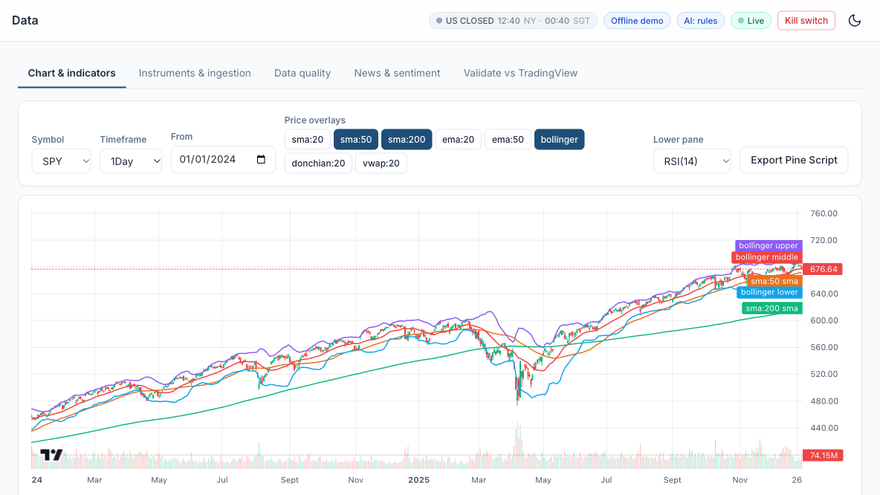
LAB 05 · SIMULATOR
Lab 05 — How to Read the Screen
Symbol, timeframe, from
SPY, 1Day, from 01/01/2024.
1
2
Price overlays
Toggle sma:50, sma:200, ema:20 and bollinger; dark buttons are switched on.
1
4
5
2
Line labels
Each overlay's latest value; the Bollinger upper, middle and lower bands wrap the price.
3
3
Lower pane
RSI(14) with 30/70 guide lines, or MACD with its histogram above and below 0.
4
Export Pine Script
Copy the v6 script, paste it into TradingView's Pine Editor and press 'Add to chart'.
5
The indicators agree when TradingView's last EMA and SMA values equal the app's line labels.
AI Powered Quantitative Trading Fundamentals · C728 · v2.0
© Tertiary Infotech Academy Pte Ltd
121

Slide 122

LAB 05 · TRADINGVIEW
Lab 05 — The Exported Strategy in TradingView
The EMA crossover exported from the simulator as Pine Script v6, pasted into TradingView's Pine Editor and added to the SPY chart: the Strategy Tester reports PnL, drawdown and profitable trades to compare with the simulator's backtest.
AI Powered Quantitative Trading Fundamentals · C728 · v2.0
© Tertiary Infotech Academy Pte Ltd
122

Slide 123
TOPIC 2 · HANDS-ON LAB
Strategy Prototype: TradingView Strategy Tester, Paper Trading from the Chart and Pipeline Reconciliation
LAB 06
Run the same MA-crossover in TradingView's Strategy Tester and in the app, reconcile the results, and try TradingView Paper Trading.
WORKFLOW
1
2
3
Simulator: Backtest the SMA 50/200 crossover in the app
▶
Simulator: Run it in TradingView
▶
Simulator: Reconcile and paper trade on TradingView
YOU'LL PRODUCE
Duration
25 min
Trade counts and net profit that agree within the expected differences (fills, costs, data).
AI Powered Quantitative Trading Fundamentals · C728 · v2.0
© Tertiary Infotech Academy Pte Ltd
123

Slide 124
LAB 06 · FOLLOW ALONG
Lab 06 — Step by Step
Course Labs > Lab 06 at http://localhost:8000 - each step's Go button opens its page pre-filled. Tick each 'You should see' before moving on.
STEP · WHERE
DO THIS
YOU SHOULD SEE
Backtest the SMA 50/200 crossover in the app
▸ Backtest SPY SMA 50/200, Alpaca costs
Run the preset backtest: SMA crossover 50/200 on SPY, Alpaca-style costs, next-bar-open fills.
✓ About 5 round trips 2018-2025; note the net CAGR and Sharpe.
1
Run it in TradingView
▸ Strategies > SMA crossover > Pine
Export the SMA crossover Pine Script and add it to an AMEX:SPY daily chart. Open the Strategy Tester.
✓ The Strategy Tester list of trades has the same entry dates (TradingView also fills on the next bar's open).
2
Reconcile and paper trade on TradingView
▸ Backtest
Explain any differences (adjusted vs raw data, commission per order, slippage ticks). Optionally connect TradingView Paper Trading and place one order from the chart.
✓ You can list at least two reasons the two backtests differ.
3
AI Powered Quantitative Trading Fundamentals · C728 · v2.0
© Tertiary Infotech Academy Pte Ltd
124

Slide 125
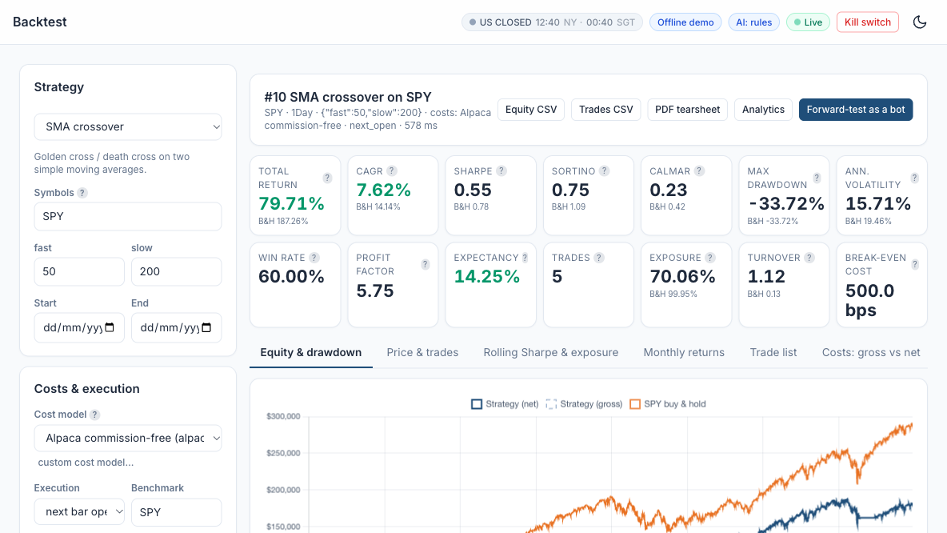
LAB 06 · SIMULATOR
Lab 06 — How to Read the Screen
Strategy and parameters
SMA crossover on SPY, fast 50 / slow 200 - the golden / death cross.
1
1
Costs and execution
Alpaca commission-free costs; fills at the next bar's open, as in TradingView.
3
2
4
Strategy vs buy-and-hold
B&H sits under each tile: CAGR 7.62% vs 14.14%, Sharpe 0.55 vs 0.78.
3
Trades and break-even
Only 5 trades; break-even cost 500 bps - costs barely matter for a slow strategy.
2
5
4
Equity curve
Net, gross and SPY. Compare the entry dates with TradingView's List of Trades.
5
Reconciled when the trade dates agree; explain any gap by adjusted vs raw data, commission and slippage.
AI Powered Quantitative Trading Fundamentals · C728 · v2.0
© Tertiary Infotech Academy Pte Ltd
125

Slide 126

LAB 06 · SIMULATOR
Lab 06 — The SMA 50/200 Backtest in the Simulator
Backtest: SMA crossover 50/200 on SPY with Alpaca commission-free costs and next-bar-open fills - return, CAGR, Sharpe, drawdown and trades beside buy-and-hold, ready to reconcile with TradingView's Strategy Tester.
AI Powered Quantitative Trading Fundamentals · C728 · v2.0
© Tertiary Infotech Academy Pte Ltd
126

Slide 127
Tea Break
15 minutes · see you at 15:40
AI Powered Quantitative Trading Fundamentals · C728 · v2.0
© Tertiary Infotech Academy Pte Ltd
127

Slide 128
TOPIC 2 · HANDS-ON LAB
Signal Stage: a Library of Trend, Mean-Reversion, Momentum and Breakout Signals
LAB 07
Pick and customise one strategy from each family and compare them after costs.
WORKFLOW
1
2
3
4
Simulator: Trend: EMA 20/50 on SPY
▶
Simulator: Mean reversion: Bollinger on KO
▶
Simulator: Momentum and breakout
▶
Simulator: Read each strategy's explanation
YOU'LL PRODUCE
Duration
25 min
Four backtests with tuned parameters and an explanation of when each family works.
AI Powered Quantitative Trading Fundamentals · C728 · v2.0
© Tertiary Infotech Academy Pte Ltd
128

Slide 129
LAB 07 · FOLLOW ALONG
Lab 07 — Step by Step
Course Labs > Lab 07 at http://localhost:8000 - each step's Go button opens its page pre-filled. Tick each 'You should see' before moving on.
STEP · WHERE
DO THIS
YOU SHOULD SEE
Trend: EMA 20/50 on SPY
▸ Backtest SPY EMA 20/50, Alpaca costs
Run the preset.
✓ Note Sharpe and max drawdown vs buy-and-hold.
1
Mean reversion: Bollinger on KO
▸ Backtest KO Bollinger 20/2
Run Bollinger Band mean reversion on KO (window 20, k 2.0), then change k to 1.5 and run it again. Set Benchmark to KO so the buy-and-hold figures under each metric are KO's, not SPY's.
✓ Win rate is high, but losses are larger than wins - 'many small wins, rare big losses'.
2
Momentum and breakout
▸ Backtest QQQ Donchian 20/10
On the Backtest page choose Time-series momentum, look-back 126, symbol QQQ, Benchmark QQQ, and run it. Then run the Donchian breakout on QQQ (entry 20, exit 10).
✓ Open the 'Price & trades' tab: buy arrows follow 20-day highs.
3
Read each strategy's explanation
▸ Strategy Library
Strategy Library: open each card and read How it works / Rule / Works best when / Watch out for.
✓ You can say which family suits a trending market and which a range-bound one.
4
AI Powered Quantitative Trading Fundamentals · C728 · v2.0
© Tertiary Infotech Academy Pte Ltd
129

Slide 130
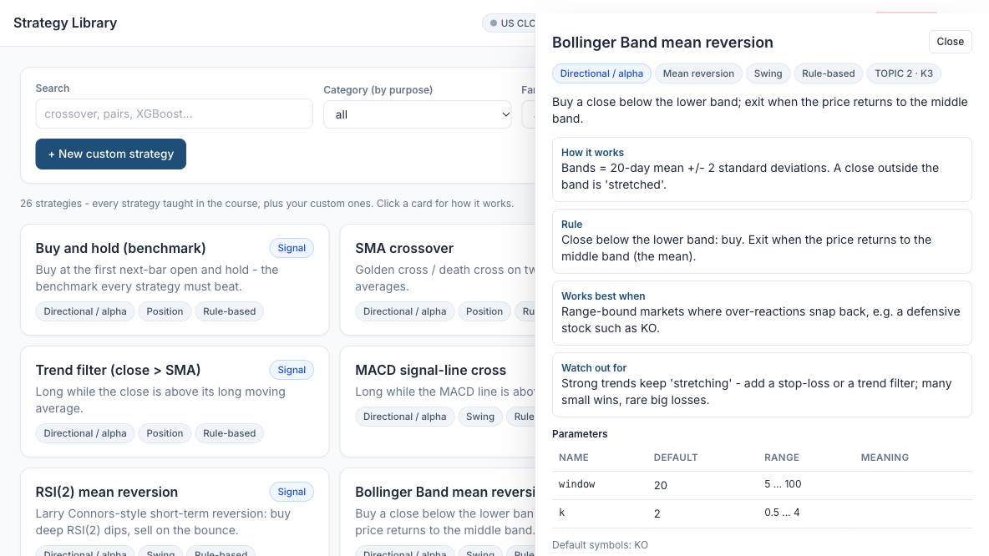
LAB 07 · SIMULATOR
Lab 07 — How to Read the Screen
Search and filter
Find a strategy by name or by purpose; 26 strategies in the library.
1
1
3
Strategy cards
Trend, mean reversion, momentum, breakout - click a card to open it.
2
2
How it works and the rule
Bollinger: buy a close below the lower band, exit back at the middle band.
4
3
When it works / watch out
Range-bound stocks such as KO; strong trends keep 'stretching' - add a stop.
4
5
Parameters
window 20 and k 2 with their ranges - the values you change in the backtest.
5
Trend and breakout suit trending markets, mean reversion suits range-bound ones - compare all four after costs.
AI Powered Quantitative Trading Fundamentals · C728 · v2.0
© Tertiary Infotech Academy Pte Ltd
130

Slide 131

LAB 07 · TRADINGVIEW
Lab 07 — Mean Reversion in TradingView, with Paper Trading
Bollinger Bands mean reversion (20, 2) on SPY with TradingView Paper Trading's order panel open. It lost 7.87% since 1993 though 59% of trades won: buying dips in a trending index hurts, so the lab runs it on KO.
AI Powered Quantitative Trading Fundamentals · C728 · v2.0
© Tertiary Infotech Academy Pte Ltd
131

Slide 132
TOPIC 2 · HANDS-ON LAB
Execution Stage: an Order Manager that Trades the Paper Account in Any Session
LAB 08
Place market, limit, stop and bracket paper orders, including an extended-hours limit order, and follow each order's lifecycle.
WORKFLOW
1
2
3
4
Simulator: Market order in the regular session
▶
Simulator: Extended-hours limit order (Singapore class hours)
▶
Simulator: Bracket order
▶
Simulator: Queue while closed and cancel
YOU'LL PRODUCE
Duration
25 min
A blotter with filled, working, queued and cancelled orders and the risk checks for each.
AI Powered Quantitative Trading Fundamentals · C728 · v2.0
© Tertiary Infotech Academy Pte Ltd
132

Slide 133
LAB 08 · FOLLOW ALONG
Lab 08 — Step by Step
Course Labs > Lab 08 at http://localhost:8000 - each step's Go button opens its page pre-filled. Tick each 'You should see' before moving on.
STEP · WHERE
DO THIS
YOU SHOULD SEE
Market order in the regular session
▸ Paper Trading > Order ticket
Open Paper Trading > Order ticket, fill in the fields below and press Send paper order. A market order buys straight away at the current price; it is accepted in the regular session.
✓ The Result panel shows ACCEPTED - all checks passed, 'BUY 10 SPY MARKET DAY -> filled', and each risk check (kill_switch, duplicate, session, allow_list, long_only, daily_loss.
1
Extended-hours limit order (Singapore class hours)
▸ same page
Keep the Step 1 ticket and change only the fields below, then press Send paper order.
✓ First send: ACCEPTED, 'BUY 10 SPY LIMIT DAY extended_hours limit <price> -> filled'. the Orders tab shows 'limit day ext-hrs', session overnight.
2
Bracket order
▸ same page
A bracket order is an entry plus two automatic exits: a take-profit (a sell limit above the price, to lock in a gain) and a stop-loss (a sell stop below it, to cap a loss).
✓ Orders tab: the parent 'buy 5 SPY market day bracket' is filled, and two sell legs appear with status new - 'limit gtc bracket (leg)' at the take-profit and 'stop gtc bracket (leg)' at the.
3
Queue while closed and cancel
▸ same page
Session (sim) = closed pretends the US market is shut (weekends and US holidays).
✓ Result: ACCEPTED, 'BUY 10 SPY LIMIT GTC limit <price> -> accepted', and the session check reads 'market closed - GTC limit order will queue for the next session'.
4
AI Powered Quantitative Trading Fundamentals · C728 · v2.0
© Tertiary Infotech Academy Pte Ltd
133

Slide 134
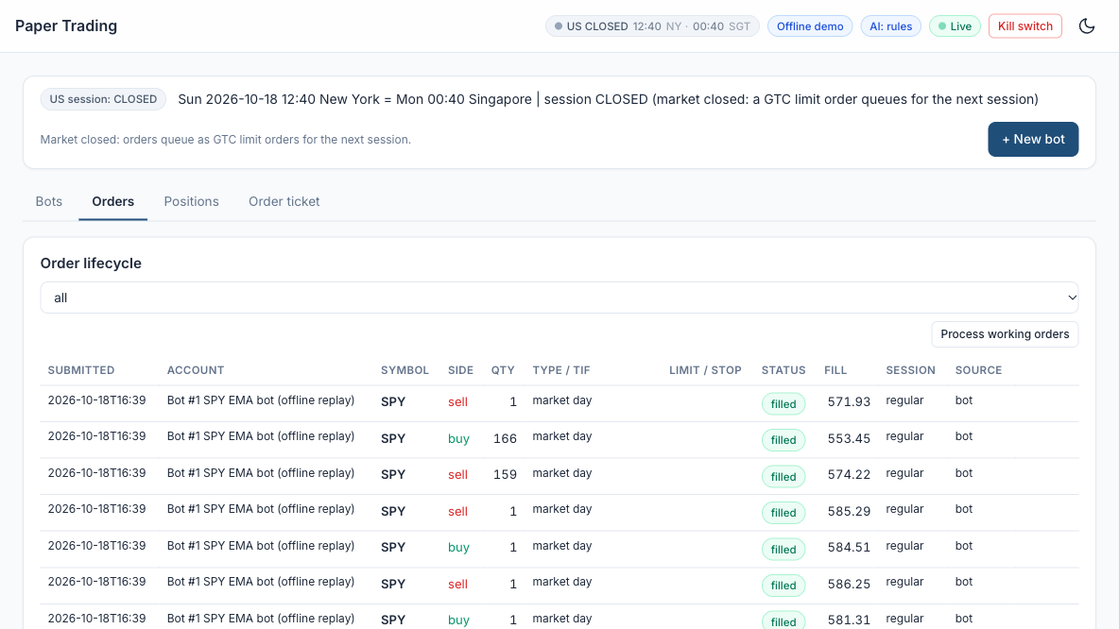
LAB 08 · SIMULATOR
Lab 08 — How to Read the Screen
Session banner
New York vs Singapore time and the US session - it decides which orders are accepted.
1
1
Tabs
Order ticket to send, Orders for the blotter, then Positions and Bots.
2
2
3
Order lifecycle filter
Show all orders, or only the filled, working, queued or cancelled ones.
3
4
5
Type / TIF
market day, limit day ext-hrs, limit gtc, bracket legs - what you sent.
4
Status, fill and session
filled, accepted or canceled; click a status badge to see the order's lifecycle.
5
Every order lists the risk checks it passed. Overnight, only LIMIT orders with extended hours are accepted.
AI Powered Quantitative Trading Fundamentals · C728 · v2.0
© Tertiary Infotech Academy Pte Ltd
134

Slide 135

LAB 08 · SIMULATOR
Lab 08 — The Paper Order Ticket
Paper Trading > Order ticket: buy 10 SPY, time in force day, default paper account. For Step 1 set Type = market and Session (sim) = regular; the banner shows the live session (here REGULAR, so all order types are accepted).
AI Powered Quantitative Trading Fundamentals · C728 · v2.0
© Tertiary Infotech Academy Pte Ltd
135

Slide 136

LAB 08 · SIMULATOR
Lab 08 — Risk Checks Passed, Order Filled
After Send paper order: ACCEPTED, all checks passed - BUY 10 SPY MARKET DAY -> filled. Every manual order passes the same pre-trade checks as the bots: kill switch, duplicate, session, allow list, long only, daily loss, max order quantity and value, max position.
AI Powered Quantitative Trading Fundamentals · C728 · v2.0
© Tertiary Infotech Academy Pte Ltd
136

Slide 137
TOPIC 2 · HANDS-ON LAB
Evaluation Stage: Performance and Risk Metrics with a Benchmark Table
LAB 09
Read the full metrics table and compare a strategy with buy-and-hold.
WORKFLOW
1
2
3
Simulator: Open the analytics
▶
Simulator: Compare with buy-and-hold
▶
Simulator: Glossary
YOU'LL PRODUCE
Duration
25 min
A metrics table you can explain line by line.
AI Powered Quantitative Trading Fundamentals · C728 · v2.0
© Tertiary Infotech Academy Pte Ltd
137

Slide 138
LAB 09 · FOLLOW ALONG
Lab 09 — Step by Step
Course Labs > Lab 09 at http://localhost:8000 - each step's Go button opens its page pre-filled. Tick each 'You should see' before moving on.
STEP · WHERE
DO THIS
YOU SHOULD SEE
Open the analytics
▸ Analytics
Analytics: choose the EMA 10/30 seeded backtest. Hover every metric for its formula.
✓ You can define Sharpe, Sortino, Calmar, max drawdown, profit factor, expectancy, exposure and turnover.
1
Compare with buy-and-hold
▸ same page
Tick the EMA backtest and 'Buy and hold SPY' and press Compare.
✓ Buy-and-hold has higher CAGR but a deeper drawdown; the strategy has lower exposure.
2
Glossary
▸ Help & Glossary
Open Help & Glossary > Metric glossary.
✓ Each formula matches the course slides.
3
AI Powered Quantitative Trading Fundamentals · C728 · v2.0
© Tertiary Infotech Academy Pte Ltd
138

Slide 139
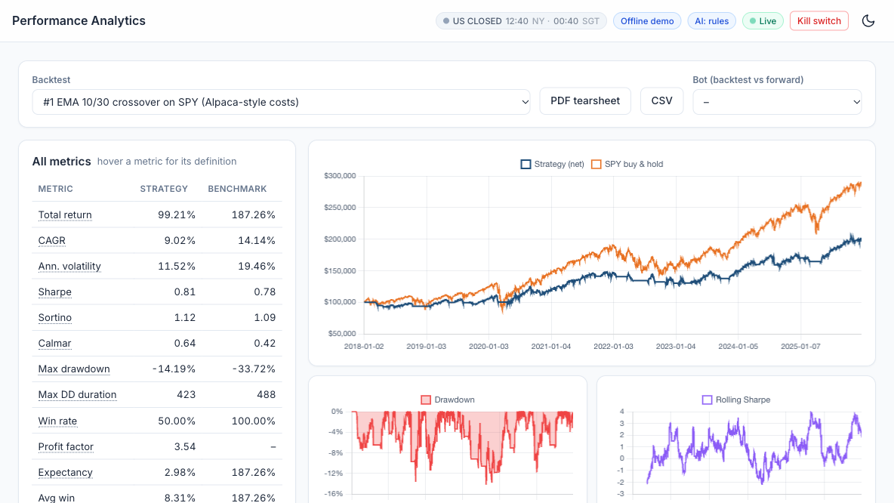
LAB 09 · SIMULATOR
Lab 09 — How to Read the Screen
Pick a backtest
EMA 10/30 on SPY; export a PDF tearsheet or CSV from here.
1
1
All metrics
Strategy vs benchmark; hover a metric for its formula. Sharpe 0.81 vs 0.78.
2
3
2
Equity vs buy-and-hold
SPY ends higher (CAGR 14.14% vs 9.02%) but swings much more.
3
Drawdown
Max drawdown -14.19% vs SPY's -33.72%: the strategy steps aside in sell-offs.
4
4
5
Rolling Sharpe
Risk-adjusted return over time; long negative spells flag a fading edge.
5
Lower return but far lower risk: judge a strategy on Sharpe, drawdown and exposure, not CAGR alone.
AI Powered Quantitative Trading Fundamentals · C728 · v2.0
© Tertiary Infotech Academy Pte Ltd
139

Slide 140

LAB 09 · SIMULATOR
Lab 09 — Strategy versus Benchmark in Analytics
Analytics for Lab 6's SMA 50/200 backtest against SPY buy-and-hold: 79.71% versus 187.26% total return, Sharpe 0.55 versus 0.78. In Lab 9 choose the EMA 10/30 backtest; hover any metric for its definition.
AI Powered Quantitative Trading Fundamentals · C728 · v2.0
© Tertiary Infotech Academy Pte Ltd
140

Slide 141
TOPIC 2 · WHAT YOU COVERED
Topic 2 Recap
1
Identify appropriate statistical algorithms and data models to test hypotheses and/or theories
2
Use appropriate analytics platforms, analytical tools, statistical methods and analytical approaches given specific analytics and reporting requirements
3
Range and application of various statistical methods and algorithms
4
Usage of analytics platforms and tools
5
Coding languages for programming of algorithms and signals
AI Powered Quantitative Trading Fundamentals · C728 · v2.0
© Tertiary Infotech Academy Pte Ltd
141

Slide 142
End of Day 1
See you at 09:30 tomorrow
AI Powered Quantitative Trading Fundamentals · C728 · v2.0
© Tertiary Infotech Academy Pte Ltd
142

Slide 143
03
TOPIC 3
ML Models and A/B Testing
LEARNING OUTCOME
Conduct statistical modelling of market data with machine learning models to derive patterns and solutions, and perform A/B testing of trading strategies based on different hypotheses.
Day 2 · Labs 10–14
AI Powered Quantitative Trading Fundamentals · C728 · v2.0
© Tertiary Infotech Academy Pte Ltd
143

Slide 144
TOPIC 3
Types of Statistical Analyses
Descriptive
What happened — mean return, volatility, skew, correlation.
Inferential
Is it real? — t-test, bootstrap, confidence intervals.
1
2
Predictive
What next? — regression, classification.
Prescriptive
What to do? — optimisation, position sizing.
3
4
AI Powered Quantitative Trading Fundamentals · C728 · v2.0
© Tertiary Infotech Academy Pte Ltd
144

Slide 145
TOPIC 3
Families of Learning Algorithms
Supervised
Features → known target: up/down, next return.
Unsupervised
Structure without a target: regimes, PCA factors.
1
2
Reinforcement
Learn a policy from rewards — execution research.
Search & simulation
Grid search, Monte Carlo, bootstrap, walk-forward.
3
4
AI Powered Quantitative Trading Fundamentals · C728 · v2.0
© Tertiary Infotech Academy Pte Ltd
145

Slide 146
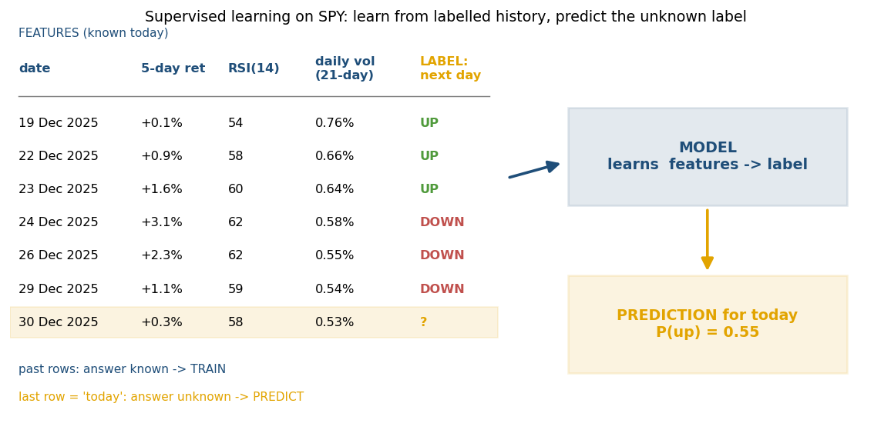
TOPIC 3
Supervised Learning: Learning from Labelled Examples
DEFINITION
The model learns a mapping from inputs (features) to a known answer (the label), using history in which the answer is already known.
IN TRADING
Features known at today's close - 5-day return, RSI, volatility. Label: did the price rise the NEXT day (classification) or by how much (regression)?
WHAT IT GIVES YOU
A prediction for a new day - P(up) = 0.55 or an expected return. A rule such as 'long if P(up) > 0.55' turns it into a position.
WATCH OUT FOR
Features must use only data known at decision time. Accuracy near 50% is normal for daily direction - judge the strategy net of costs.
AI Powered Quantitative Trading Fundamentals · C728 · v2.0
© Tertiary Infotech Academy Pte Ltd
146

Slide 147
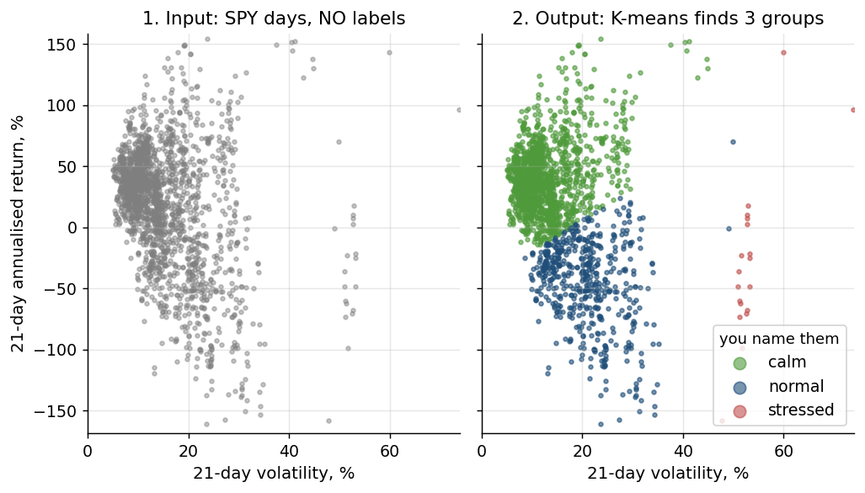
TOPIC 3
Unsupervised Learning: Finding Structure Without Labels
DEFINITION
There is no answer key. The algorithm groups or compresses the data by similarity, and you decide what the groups mean.
IN TRADING
Cluster days by return and volatility into regimes; PCA reduces many correlated assets to a few factors; cluster stocks for diversification.
WHAT IT GIVES YOU
A group per day or asset (calm / normal / stressed) or a few factors - inputs to a decision, such as cutting position size when stressed, not trades by themselves.
WATCH OUT FOR
Clusters have no built-in meaning and k is your choice. Fit on past data only and re-check as the market changes.
AI Powered Quantitative Trading Fundamentals · C728 · v2.0
© Tertiary Infotech Academy Pte Ltd
147

Slide 148
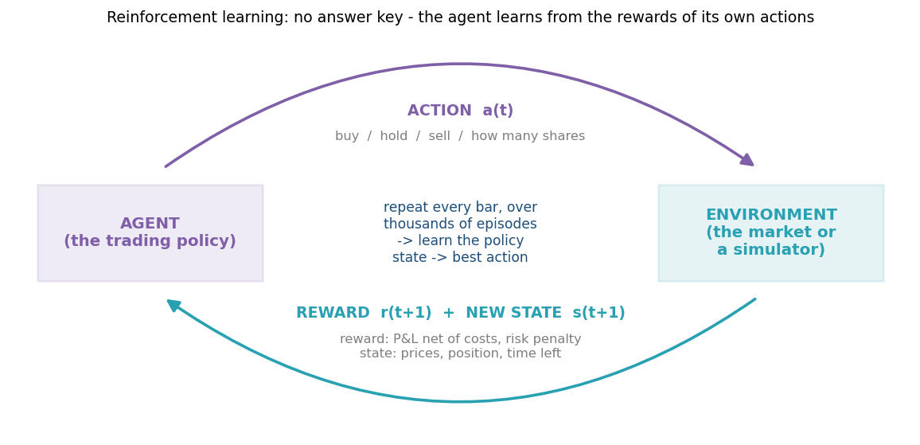
TOPIC 3
Reinforcement Learning: Learning by Action and Reward
DEFINITION
An agent observes a state, takes an action and receives a reward; by trial and error it learns a policy that maximises total reward over time.
IN TRADING
State: prices, position, time left. Action: buy, hold, sell or how many shares. Reward: P&L net of costs, minus a penalty for risk.
WHAT IT GIVES YOU
A policy - the best action for each state. Used for optimal execution of large orders, market making and dynamic hedging, mostly at banks and research labs.
WATCH OUT FOR
Needs a realistic simulator and huge amounts of experience; it learns to exploit any flaw in the simulator. Unstable and hard to explain - rarely the first tool.
AI Powered Quantitative Trading Fundamentals · C728 · v2.0
© Tertiary Infotech Academy Pte Ltd
148

Slide 149
TOPIC 3
Supervised vs Unsupervised vs Reinforcement Learning
Supervised
Unsupervised
Reinforcement
Learns from
Labelled history: features + the known answer
Unlabelled data: features only
Its own experience: states, actions, rewards
Question it answers
What will happen? - predict a target
What patterns exist? - group or compress
What should I do? - choose the next action
Feedback
Error against the correct answer
None - judged by how useful the groups are
A reward, often delayed (profit, cost)
Typical algorithms
Logistic regression, random forest, XGBoost, LSTM
K-means, hierarchical clustering, PCA
Q-learning, policy gradients (PPO)
Trading example
P(SPY up tomorrow) from RSI and recent returns
Calm / normal / stressed market regimes
An agent slicing a 100,000-share order to cut cost
Main risk
Overfitting noise; look-ahead leakage
Meaningless or unstable clusters
Exploiting simulator flaws; unstable training
AI Powered Quantitative Trading Fundamentals · C728 · v2.0
© Tertiary Infotech Academy Pte Ltd
149

Slide 150
TOPIC 3
Supervised Models for Trading Signals
Linear / logistic regression
Interpretable baselines; P(up) from a weighted sum.
Decision tree & random forest
Threshold splits; averaged trees reduce variance.
1
2
XGBoost
Sequential boosted trees — strongest on tabular features.
Neural networks
MLP, LSTM, Transformer — data-hungry, easy to overfit.
3
4
AI Powered Quantitative Trading Fundamentals · C728 · v2.0
© Tertiary Infotech Academy Pte Ltd
150

Slide 151
TOPIC 3
Unsupervised Models for Regimes
K-means
Minimise within-cluster variance; choose k by elbow or silhouette.
Hierarchical clustering
Dendrogram of similar assets for diversification.
1
2
PCA
First component ≈ the market; yield curve = level, slope, curvature.
Fit on the past only
Assign new days to regimes as they arrive.
3
4
AI Powered Quantitative Trading Fundamentals · C728 · v2.0
© Tertiary Infotech Academy Pte Ltd
151

Slide 152
TOPIC 3
Statistical Modelling Techniques
Returns, not prices
Closer to stationary; avoids spurious regression.
Time-ordered validation
TimeSeriesSplit and walk-forward — never shuffle.
1
2
Leak-free features
Lags and rolling windows known at decision time.
Regularise
L1/L2, depth limits, early stopping, fewer features.
3
4
AI Powered Quantitative Trading Fundamentals · C728 · v2.0
© Tertiary Infotech Academy Pte Ltd
152

Slide 153
TOPIC 3
A/B Testing Two Strategy Variants
State H0 and H1 first
H0: equal mean returns; H1: B is higher. α = 5%.
Welch's t-test
Compare mean daily returns with unequal variances.
1
2
Bootstrap the Sharpe difference
Resample returns; 95% CI excluding 0?
Mind multiple testing
100 variants → ~5 false 'winners' by chance.
3
4
AI Powered Quantitative Trading Fundamentals · C728 · v2.0
© Tertiary Infotech Academy Pte Ltd
153

Slide 154

TOPIC 3
Algorithm: Logistic Regression for Direction
HOW IT WORKS
Fits P(up tomorrow) = 1 / (1 + e^-(b0 + b1 x1 + ...)) from features known today.
RULE
Go long when P(up) exceeds a threshold such as 0.55; otherwise stay flat.
WORKS BEST WHEN
A transparent baseline: each coefficient shows how a feature moves the probability.
WATCH OUT FOR
Only linear effects unless you engineer features; daily direction is close to a coin toss.
AI Powered Quantitative Trading Fundamentals · C728 · v2.0
© Tertiary Infotech Academy Pte Ltd
154

Slide 155

TOPIC 3
Algorithm: Decision Tree and Random Forest
HOW IT WORKS
A tree splits the data on feature thresholds (e.g. RSI < 30) into leaves with an up/down share.
RULE
A random forest averages hundreds of trees, each grown on a random sample of rows and features.
WORKS BEST WHEN
Non-linear, interacting signals - e.g. oversold AND low volatility.
WATCH OUT FOR
Deep trees memorise noise; limit depth and leaf size and validate walk-forward.
AI Powered Quantitative Trading Fundamentals · C728 · v2.0
© Tertiary Infotech Academy Pte Ltd
155

Slide 156

TOPIC 3
Algorithm: Gradient Boosting (XGBoost)
HOW IT WORKS
Builds trees one after another; each new tree corrects the errors of the ensemble so far.
RULE
Prediction = sum of many small trees x learning rate; stop early when test loss stops falling.
WORKS BEST WHEN
Tabular features such as returns, indicators and volatility - usually the strongest model.
WATCH OUT FOR
Training loss keeps falling while test loss rises: classic overfitting (see the chart).
AI Powered Quantitative Trading Fundamentals · C728 · v2.0
© Tertiary Infotech Academy Pte Ltd
156

Slide 157

TOPIC 3
Algorithm: K-Means Clustering for Market Regimes
HOW IT WORKS
Groups days into k clusters by minimising the distance of each day to its cluster centre.
RULE
Features: rolling return and volatility (standardised). Name clusters by their averages.
WORKS BEST WHEN
Switching or sizing strategies by regime: trend in calm markets, cut risk when stressed.
WATCH OUT FOR
Fit on past data only; choose k with the elbow or silhouette method; regimes shift.
AI Powered Quantitative Trading Fundamentals · C728 · v2.0
© Tertiary Infotech Academy Pte Ltd
157

Slide 158

TOPIC 3
Algorithm: Principal Component Analysis (PCA)
HOW IT WORKS
Finds uncorrelated combinations of assets that explain the most variance of returns.
RULE
PC1 of a stock universe is 'the market'; later PCs are sector or style factors.
WORKS BEST WHEN
Reducing many correlated features; building factor-neutral and pairs portfolios.
WATCH OUT FOR
Standardise first; components change over time; PCs are statistical, not economic, factors.
AI Powered Quantitative Trading Fundamentals · C728 · v2.0
© Tertiary Infotech Academy Pte Ltd
158

Slide 159

TOPIC 3
Method: Walk-Forward Validation
HOW IT WORKS
Train on a past window, test on the next unseen block, then roll forward and repeat.
RULE
Never shuffle time series; each test block is genuinely out of sample.
WORKS BEST WHEN
Estimating how a model or parameter set would really have performed live.
WATCH OUT FOR
Overlapping targets leak information - leave a gap between train and test.
AI Powered Quantitative Trading Fundamentals · C728 · v2.0
© Tertiary Infotech Academy Pte Ltd
159

Slide 160

TOPIC 3
Method: A/B Testing Two Strategy Variants
HOW IT WORKS
Compare variant A and B on the same days: H0 'no difference' vs H1 'B is better'.
RULE
Welch / paired t-test on daily returns; bootstrap a 95% CI of the Sharpe difference.
WORKS BEST WHEN
Deciding which parameter set or filter to promote to paper trading.
WATCH OUT FOR
If the CI contains 0, do not reject H0; testing 100 variants gives ~5 false winners.
AI Powered Quantitative Trading Fundamentals · C728 · v2.0
© Tertiary Infotech Academy Pte Ltd
160

Slide 161
TOPIC 3
From Probability to Position
1
2
3
4
5
▶
▶
▶
▶
Build leak-free features
Train on past window
Predict P(up) for tomorrow
Long if P(up) > 0.55, else flat
Backtest net of costs
Judge the model by the net-of-cost strategy, not by accuracy alone.
AI Powered Quantitative Trading Fundamentals · C728 · v2.0
© Tertiary Infotech Academy Pte Ltd
161

Slide 162
TOPIC 3 · PAIRS TRADING
Pairs Trading: a Hedging Algorithm
Why it is a hedge
Long the cheap stock, short the rich one in hedge-ratio proportion: market moves largely cancel
Choose the pair
Economically linked stocks (e.g. KO and PEP) that are cointegrated, not merely correlated
1
2
Hedge ratio and spread
Regress log price A on log price B: slope = hedge ratio, residual = the spread (Engle-Granger)
Test the spread
ADF test on the residual: a stationary spread tends to revert to its mean
3
4
Trade the z-score
Enter when |z| > 2, exit as z returns towards 0; trade both legs on the next bar
Risks
Cointegration breaks, hedge ratio drifts, double costs, short-borrow, multiple testing
5
6
AI Powered Quantitative Trading Fundamentals · C728 · v2.0
© Tertiary Infotech Academy Pte Ltd
162

Slide 163
TOPIC 3 · PAIRS TRADING
The Pairs-Trading Algorithm Step by Step
1
2
3
4
5
6
▶
▶
▶
▶
▶
Select an economically linked pair
Estimate the hedge ratio (OLS)
Test cointegration (ADF on residual)
Compute the spread z-score
Enter / exit both legs
Monitor and re-test
Gatev, Goetzmann and Rouwenhorst (2006): a simple pairs rule on US stocks earned average annualised excess returns of up to 11% (1962-2002); later studies find smaller and less consistent profits.
AI Powered Quantitative Trading Fundamentals · C728 · v2.0
© Tertiary Infotech Academy Pte Ltd
163

Slide 164

TOPIC 3
Algorithm: Pairs Trading (Hedged Statistical Arbitrage)
HOW IT WORKS
Long one stock, short a cointegrated partner in hedge-ratio proportion: market moves cancel.
RULE
Spread z > +2: short A / long B. z < -2: long A / short B. Exit as z returns to 0.
WORKS BEST WHEN
Economically linked stocks (KO/PEP) whose spread has a stable mean.
WATCH OUT FOR
Cointegration can break; costs on both legs; short-borrow; screening many pairs.
AI Powered Quantitative Trading Fundamentals · C728 · v2.0
© Tertiary Infotech Academy Pte Ltd
164

Slide 165
TOPIC 3 · HANDS-ON LAB
Strategy-Search Stage: Grid Search, Out-of-Sample Ranking and Decay
LAB 10
Grid-search SMA crossover parameters in-sample and measure how the ranking decays out of sample.
WORKFLOW
1
2
3
Simulator: Run the grid
▶
Simulator: Read the decay
▶
Simulator: Walk-forward
YOU'LL PRODUCE
Duration
25 min
IS and OOS Sharpe heatmaps, a rank correlation and a robust parameter region.
AI Powered Quantitative Trading Fundamentals · C728 · v2.0
© Tertiary Infotech Academy Pte Ltd
165

Slide 166
LAB 10 · FOLLOW ALONG
Lab 10 — Step by Step
Course Labs > Lab 10 at http://localhost:8000 - each step's Go button opens its page pre-filled. Tick each 'You should see' before moving on.
STEP · WHERE
DO THIS
YOU SHOULD SEE
Run the grid
▸ Research > Grid SPY SMA cross
Research > Strategy search: SMA crossover on SPY, in-sample to 2021-12-31, Alpaca costs. Press Search.
✓ About 24 parameter sets; two heatmaps appear.
1
Read the decay
▸ Research > Strategy search
Compare the in-sample and out-of-sample heatmaps and the IS->OOS rank correlation.
✓ You can explain why the single best in-sample cell is usually not the best out of sample, and why a robust region is preferred.
2
Walk-forward
▸ Research > Walk-forward SPY
Research > Walk-forward: SMA crossover on SPY (3-year train, 1-year test).
✓ The stitched out-of-sample equity curve and the parameters chosen in each window.
3
AI Powered Quantitative Trading Fundamentals · C728 · v2.0
© Tertiary Infotech Academy Pte Ltd
166

Slide 167
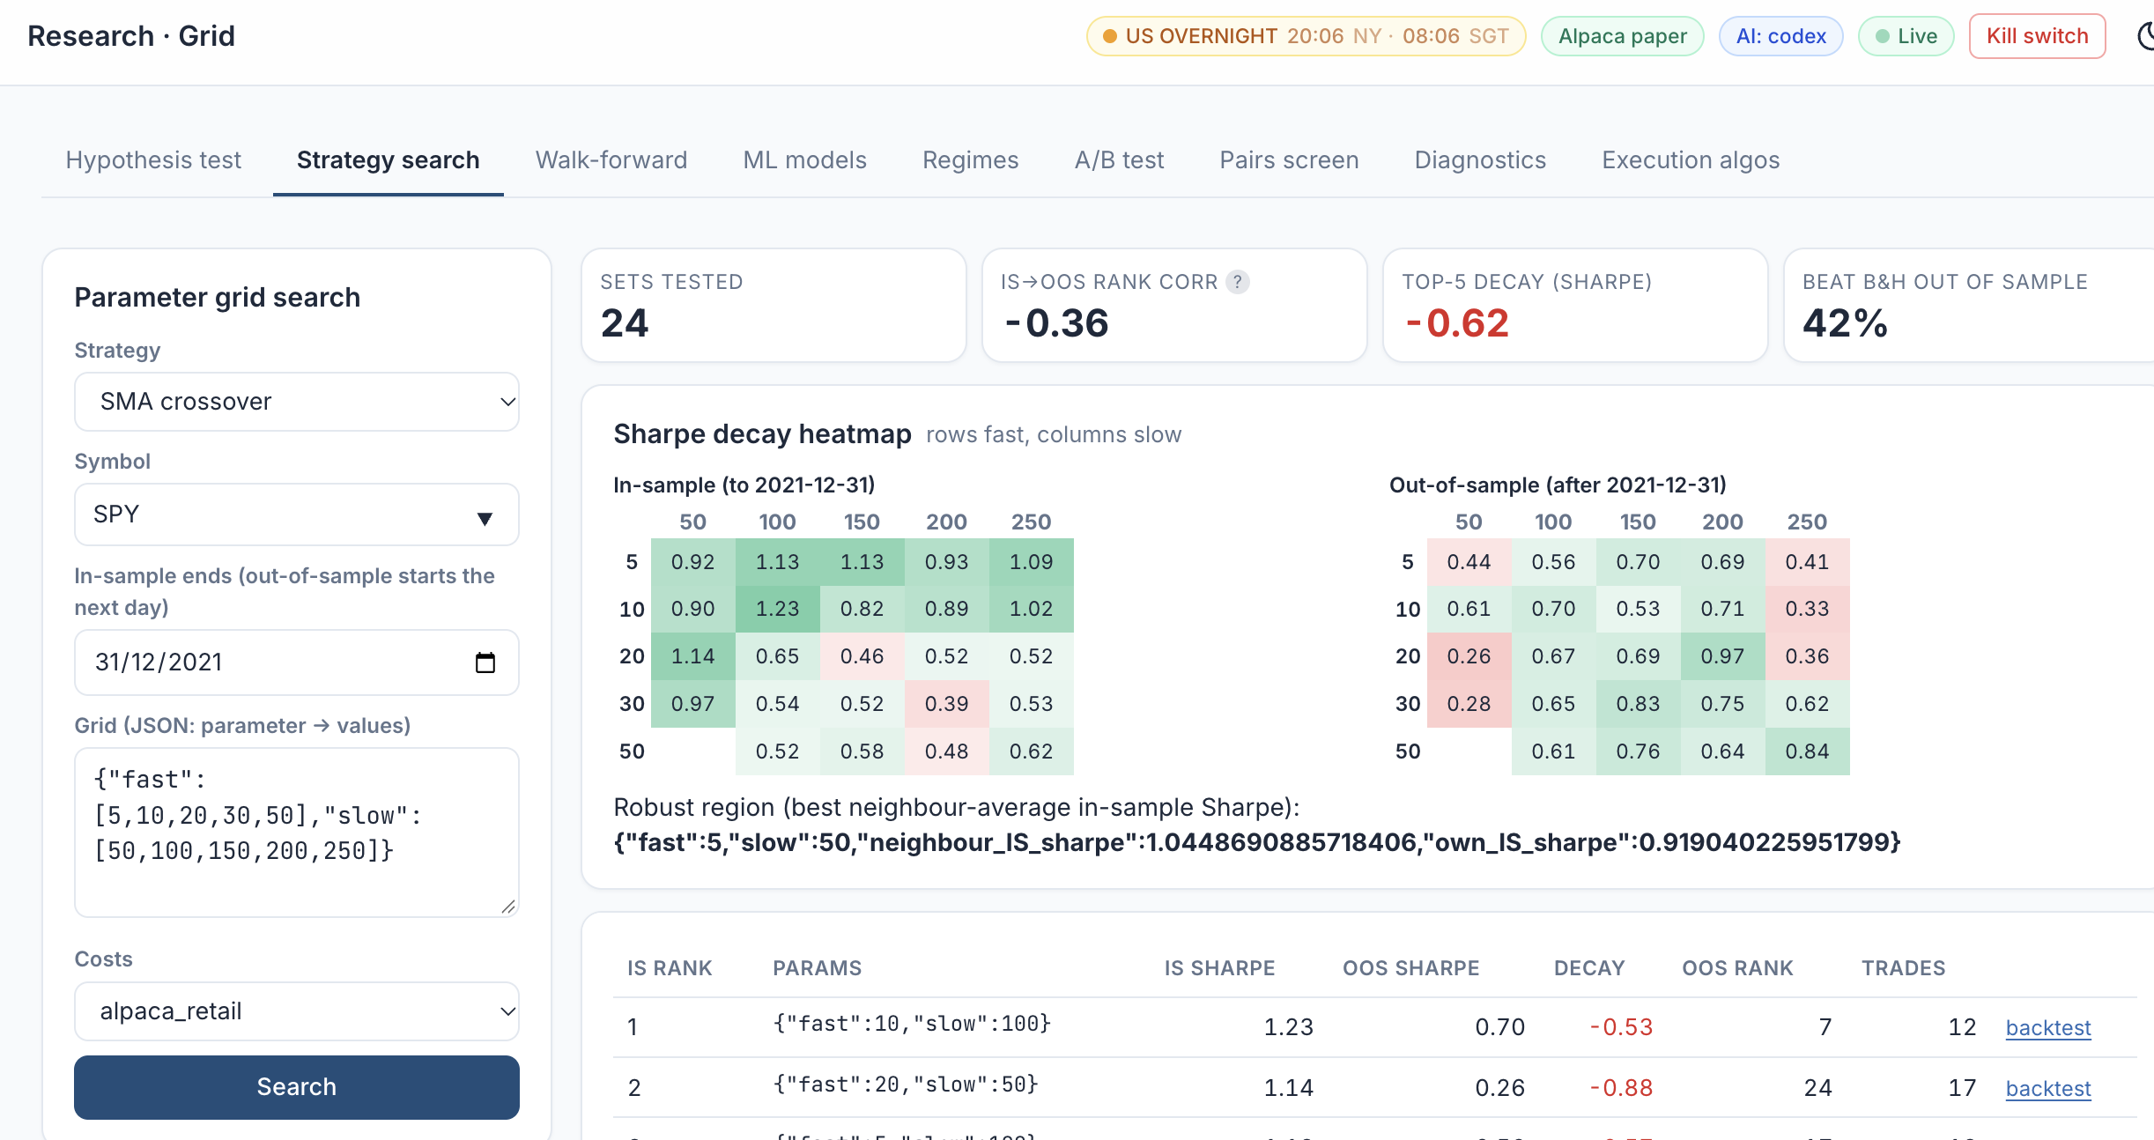
LAB 10 · SIMULATOR
Lab 10 — How to Read the Screen
The grid
SMA crossover on SPY: fast 5-50 x slow 50-250, in-sample to 31/12/2021.
1
1
2
Decay summary
24 sets; IS -> OOS rank correlation -0.36: the in-sample ranking does not hold.
2
3
4
In-sample heatmap
Greener = higher Sharpe to 2021. The best cell, 10/100, scores 1.23.
3
Out-of-sample heatmap
The same cells after 2021: 10/100 drops to 0.70 and the winners move.
5
4
Robust region
Prefer the cell whose neighbours are also good, not the single best cell.
5
The best in-sample setting is rarely the best out of sample: choose a robust region, then walk-forward.
AI Powered Quantitative Trading Fundamentals · C728 · v2.0
© Tertiary Infotech Academy Pte Ltd
167

Slide 168
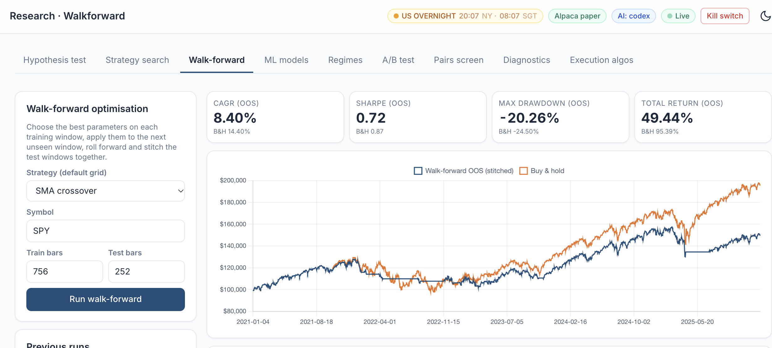
LAB 10 · SIMULATOR
Lab 10 — Walk-Forward: Re-Tune, Then Test Unseen
Research > Walk-forward: SMA crossover on SPY, 3-year train, 1-year test. Stitched out of sample: CAGR 8.40% (buy-and-hold 14.40%), Sharpe 0.72 (0.87), max drawdown -20.26% (-24.50%).
AI Powered Quantitative Trading Fundamentals · C728 · v2.0
© Tertiary Infotech Academy Pte Ltd
168

Slide 169
TOPIC 3 · HANDS-ON LAB
ML-Signal Stage: a Walk-Forward Classifier from Probability to Position
LAB 11
Train logistic regression, random forest and XGBoost walk-forward and trade P(up) > threshold.
WORKFLOW
1
2
3
Simulator: Train the classifiers
▶
Simulator: Backtest an ML strategy
▶
Simulator: Check for leakage
YOU'LL PRODUCE
Duration
25 min
Accuracy / AUC table, feature importance and a net-of-cost backtest of the ML signal.
AI Powered Quantitative Trading Fundamentals · C728 · v2.0
© Tertiary Infotech Academy Pte Ltd
169

Slide 170
LAB 11 · FOLLOW ALONG
Lab 11 — Step by Step
Course Labs > Lab 11 at http://localhost:8000 - each step's Go button opens its page pre-filled. Tick each 'You should see' before moving on.
STEP · WHERE
DO THIS
YOU SHOULD SEE
Train the classifiers
▸ Research > ML SPY
Research > ML models on SPY, threshold 0.55.
✓ AUC close to 0.5 - daily direction is close to a coin toss; read the verdict.
1
Backtest an ML strategy
▸ Backtest SPY XGBoost
Backtest 'ML: XGBoost (walk-forward)' on SPY.
✓ Judge the model by the net-of-cost strategy, not by accuracy.
2
Check for leakage
▸ Research > Diagnostics
Research > Diagnostics on 'ML: logistic regression'.
✓ Look-ahead check PASS: refits use only past bars.
3
AI Powered Quantitative Trading Fundamentals · C728 · v2.0
© Tertiary Infotech Academy Pte Ltd
170

Slide 171
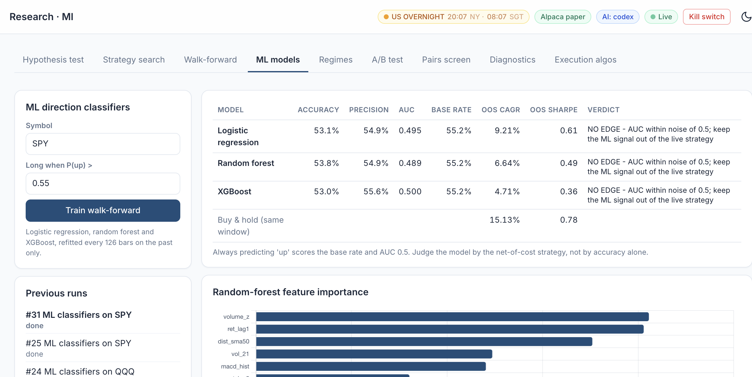
LAB 11 · SIMULATOR
Lab 11 — How to Read the Screen
Train walk-forward
SPY, long when P(up) > 0.55; every model refits every 126 bars on past data only.
1
1
Accuracy, AUC, base rate
53-54% accuracy is below the 55.2% base rate; AUC about 0.5 = a coin toss.
2
3
4
2
Net-of-cost result
OOS Sharpe 0.36-0.61 vs buy-and-hold 0.78: none beats simply holding SPY.
3
Verdict
NO EDGE for all three models: keep the ML signal out of the live strategy.
5
4
Feature importance
The inputs the random forest leaned on: volume, lagged return, distance to SMA 50.
5
A model that cannot beat the base rate, with AUC near 0.5, has no edge - however clever it looks.
AI Powered Quantitative Trading Fundamentals · C728 · v2.0
© Tertiary Infotech Academy Pte Ltd
171

Slide 172
TOPIC 3 · HANDS-ON LAB
Regime-Filter Stage: PCA and K-Means as a Gate on the Signals
LAB 12
Find market regimes with walk-forward K-means and gate a signal in the high-volatility regime.
WORKFLOW
1
2
Simulator: Analyse regimes
▶
Simulator: Backtest the regime-filtered strategy
YOU'LL PRODUCE
Duration
20 min
PCA explained variance, a regime timeline and gated vs ungated performance.
AI Powered Quantitative Trading Fundamentals · C728 · v2.0
© Tertiary Infotech Academy Pte Ltd
172

Slide 173
LAB 12 · FOLLOW ALONG
Lab 12 — Step by Step
Course Labs > Lab 12 at http://localhost:8000 - each step's Go button opens its page pre-filled. Tick each 'You should see' before moving on.
STEP · WHERE
DO THIS
YOU SHOULD SEE
Analyse regimes
▸ Research > Regimes SPY
Research > Regimes: SPY, 3 clusters, gate the EMA crossover.
✓ PC1 explains the largest share of variance (the market factor); the 2020 crash is in the stress regime.
1
Backtest the regime-filtered strategy
▸ Backtest SPY regime filter
Backtest 'Regime-filtered strategy (K-means gate)'.
✓ Compare max drawdown with the ungated EMA crossover.
2
AI Powered Quantitative Trading Fundamentals · C728 · v2.0
© Tertiary Infotech Academy Pte Ltd
173

Slide 174
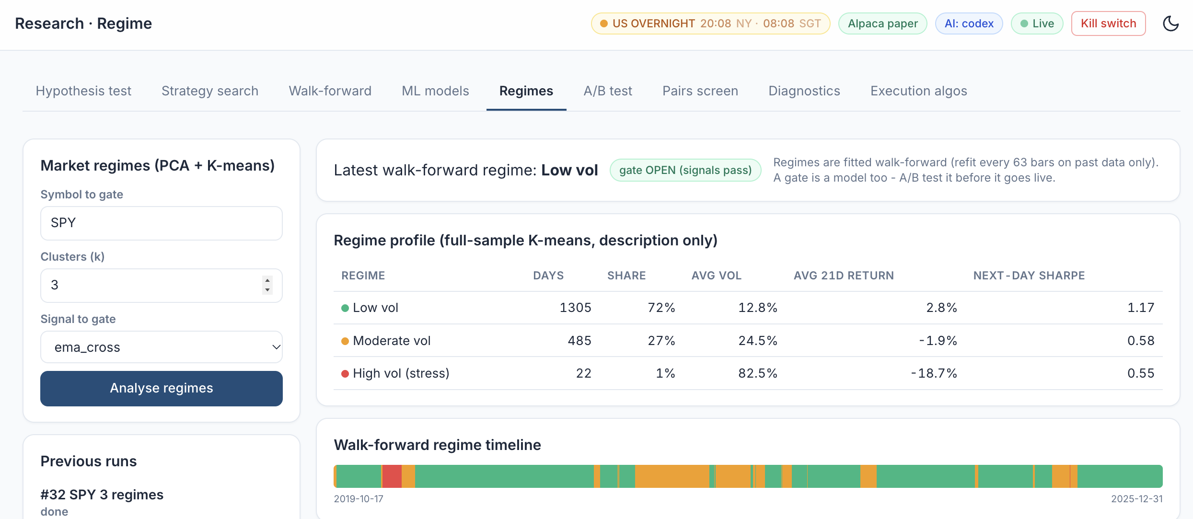
LAB 12 · SIMULATOR
Lab 12 — How to Read the Screen
Settings
SPY, 3 clusters (k), gating the EMA crossover signal.
1
Today's regime and gate
Low vol, gate OPEN: signals pass. Regimes are refitted walk-forward on past data only.
1
2
2
How common each regime is
Low vol 72% of days, moderate vol 27%, high-vol stress 1% (22 days).
3
3
4
How each regime behaves
Stress: 82.5% vol and -18.7% over 21 days; low vol has the best next-day Sharpe (1.17).
4
5
Regime timeline
The walk-forward regime day by day, 2019-2025: red = stress (the 2020 crash), orange = moderate.
5
Trade the signal only while the gate is open - and A/B test the gate before it goes live.
AI Powered Quantitative Trading Fundamentals · C728 · v2.0
© Tertiary Infotech Academy Pte Ltd
174

Slide 175
TOPIC 3 · HANDS-ON LAB
A/B-Test Stage: a Statistical Decision before Capital Moves
LAB 13
Decide statistically between two variants before moving capital.
WORKFLOW
1
2
Simulator: Run the A/B test
▶
Simulator: Your own variants
YOU'LL PRODUCE
Duration
20 min
Welch and paired t-tests, a bootstrap Sharpe CI and a decision with a multiple-testing caution.
AI Powered Quantitative Trading Fundamentals · C728 · v2.0
© Tertiary Infotech Academy Pte Ltd
175

Slide 176
LAB 13 · FOLLOW ALONG
Lab 13 — Step by Step
Course Labs > Lab 13 at http://localhost:8000 - each step's Go button opens its page pre-filled. Tick each 'You should see' before moving on.
STEP · WHERE
DO THIS
YOU SHOULD SEE
Run the A/B test
▸ Research > A/B trend_filter vs dip_buy
Research > A/B test: A = Trend filter, B = Dip buy, SPY, alpha 0.05, 20 variants tried.
✓ Read the decision; if the CI contains 0, do not reject H0.
1
Your own variants
▸ Research > A/B test
A = EMA crossover {"fast": 10, "slow": 30}, B = EMA crossover {"fast": 20, "slow": 50}.
✓ You can explain the Bonferroni-adjusted alpha.
2
AI Powered Quantitative Trading Fundamentals · C728 · v2.0
© Tertiary Infotech Academy Pte Ltd
176

Slide 177
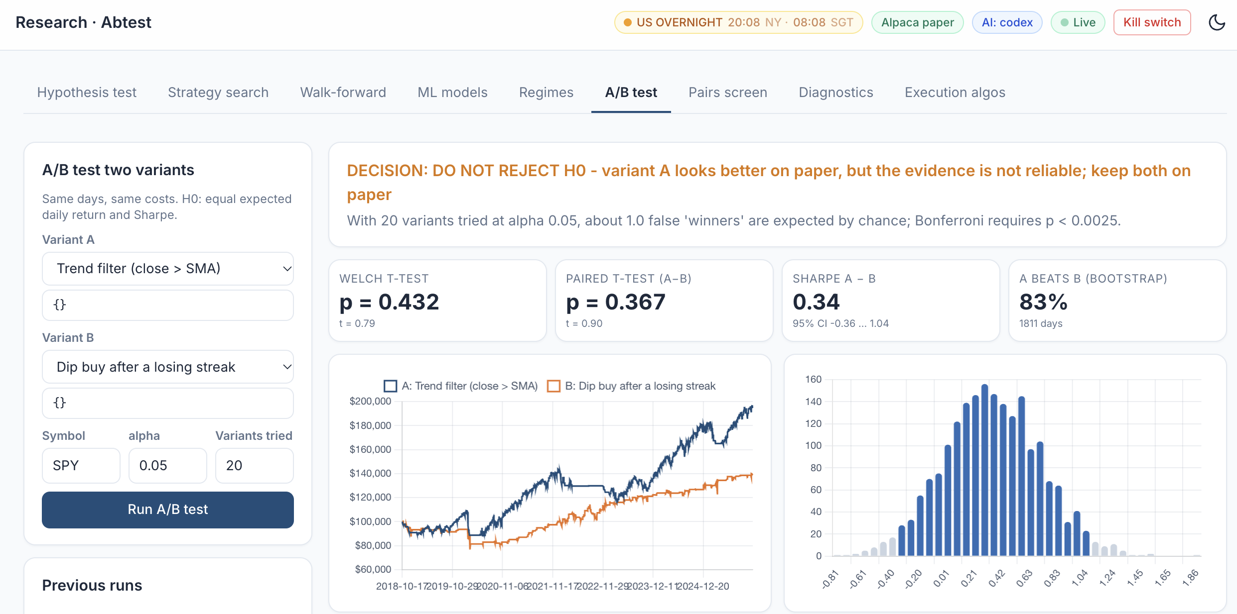
LAB 13 · SIMULATOR
Lab 13 — How to Read the Screen
1
Set up the test
A = Trend filter, B = Dip buy, SPY, alpha 0.05, 20 variants tried. H0: no difference.
2
The decision
DO NOT REJECT H0. 20 tries at 5% expect 1 lucky winner; Bonferroni needs p < 0.0025.
1
2
3
Welch and paired t-tests
p 0.432 and 0.367, far above 0.05. Paired is the better test: same days, same market.
3
4
5
6
4
Sharpe gap and bootstrap
A - B = 0.34, but the 95% CI -0.36 to 1.04 contains 0. A wins 83% of resamples - not enough.
5
Equity curves
A ends near $195k, B near $138k. Tempting - but a nicer curve is not proof.
6
Bootstrap distribution
Resampled Sharpe gaps; dark bars are the 95% CI, and 0 falls inside them.
Keep both variants on paper: move capital only when p beats the Bonferroni alpha and the CI excludes 0.
AI Powered Quantitative Trading Fundamentals · C728 · v2.0
© Tertiary Infotech Academy Pte Ltd
177

Slide 178
LAB 13 · THE DECISION
Lab 13 — How to Reach the A/B Decision
Read the screen in this order. H0: A and B have the same expected daily return and Sharpe.
1
2
3
4
5
▶
▶
▶
▶
Don't trust the chart. A's curve looks better, but 7 years of noisy daily returns can fool you.
Paired t-test on A − B (same days, same market): p = 0.367, above alpha 0.05.
Bootstrap Sharpe CI −0.36 … 1.04 contains 0, so 'no difference' is still plausible.
20 variants × 0.05 = 1 lucky 'winner' expected. Bonferroni: 0.05 ÷ 20 = 0.0025.
Decision: DO NOT REJECT H0. Keep both on paper and record the result.
Step 2 (EMA 10/30 vs EMA 20/50): read the same three numbers - paired p, the CI vs 0 and Bonferroni 0.0025 - and record them for the PP.
AI Powered Quantitative Trading Fundamentals · C728 · v2.0
© Tertiary Infotech Academy Pte Ltd
178

Slide 179
TOPIC 3 · HANDS-ON LAB
Pairs Stage: a Hedged, Market-Neutral Statistical-Arbitrage Sleeve
LAB 14
Screen pairs for cointegration and backtest a market-neutral KO/PEP spread.
WORKFLOW
1
2
Simulator: Screen the pairs
▶
Simulator: Backtest KO/PEP
YOU'LL PRODUCE
Duration
25 min
An Engle-Granger screen and a pairs backtest with beta near zero.
AI Powered Quantitative Trading Fundamentals · C728 · v2.0
© Tertiary Infotech Academy Pte Ltd
179

Slide 180
LAB 14 · FOLLOW ALONG
Lab 14 — Step by Step
Course Labs > Lab 14 at http://localhost:8000 - each step's Go button opens its page pre-filled. Tick each 'You should see' before moving on.
STEP · WHERE
DO THIS
YOU SHOULD SEE
Screen the pairs
▸ Research > Pairs screen
Research > Pairs screen (formation to 2022-12-31).
✓ High correlation does not imply cointegration - compare the corr and ADF columns.
1
Backtest KO/PEP
▸ Backtest KO/PEP pairs
Backtest the pairs strategy on KO, PEP (both legs, short leg allowed, borrow cost charged).
✓ Beta to SPY near 0 in 'All metrics'; the trade list has long and short legs.
2
AI Powered Quantitative Trading Fundamentals · C728 · v2.0
© Tertiary Infotech Academy Pte Ltd
180

Slide 181
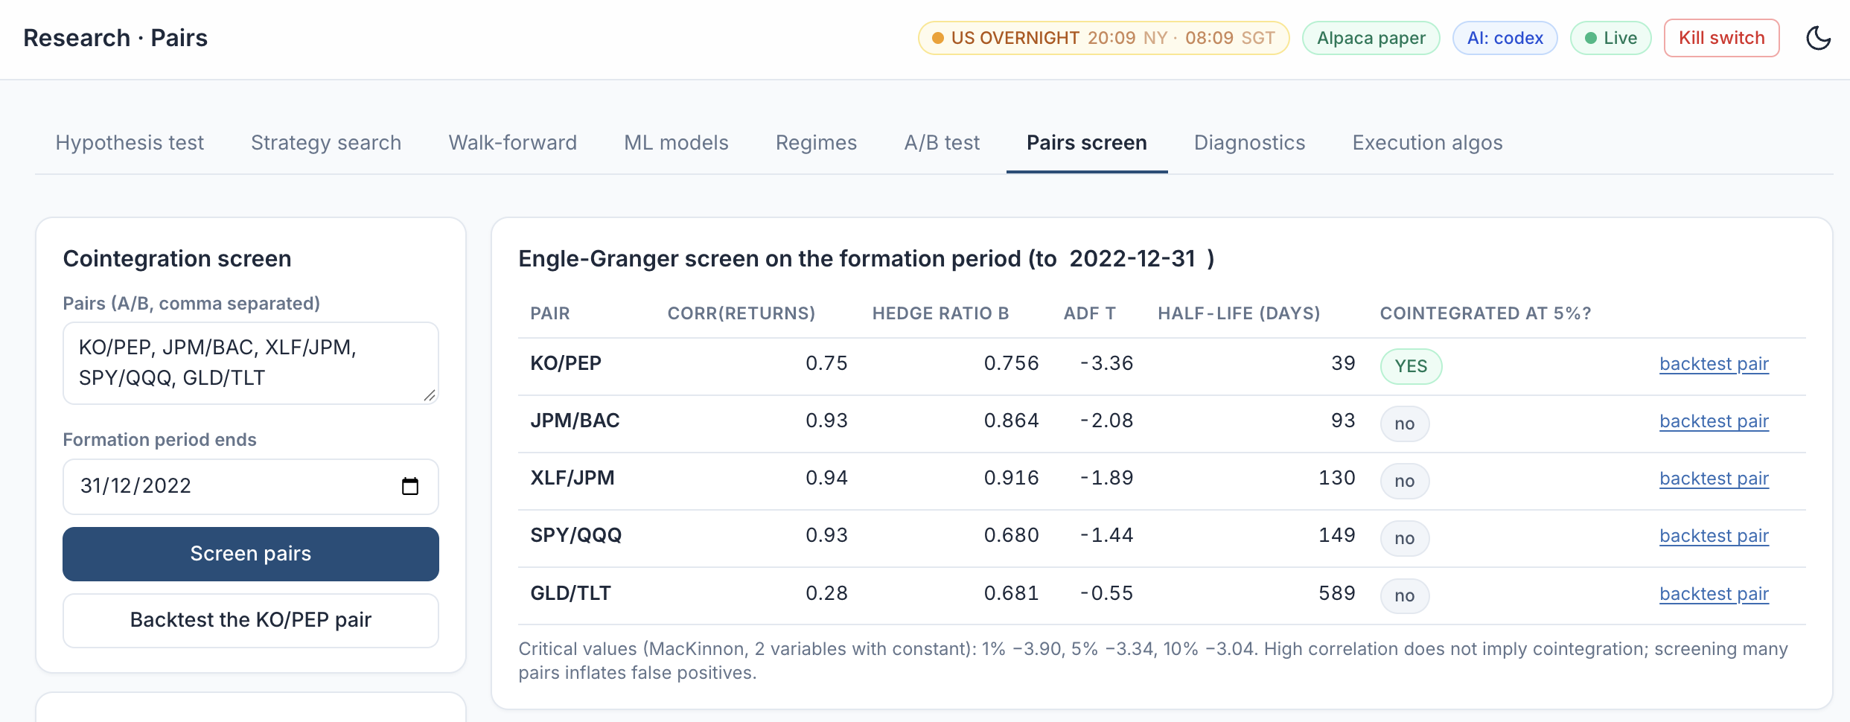
LAB 14 · SIMULATOR
Lab 14 — How to Read the Screen
Pairs and formation period
Five candidate pairs, tested on data to 31/12/2022 only.
1
KO/PEP: cointegrated
ADF t -3.36 beats the 5% critical value -3.34; the spread's half-life is 39 days.
1
2
2
3
JPM/BAC: correlated, not cointegrated
0.93 correlation but ADF t -2.08: the spread can drift away for good.
3
4
Critical values
1% -3.90, 5% -3.34, 10% -3.04. Screening many pairs inflates false positives.
4
Trade a spread only for a cointegrated pair (KO/PEP), then check its beta to SPY is near 0.
AI Powered Quantitative Trading Fundamentals · C728 · v2.0
© Tertiary Infotech Academy Pte Ltd
181

Slide 182
TOPIC 3 · WHAT YOU COVERED
Topic 3 Recap
1
Conduct statistical modelling of data to derive patterns and solutions
2
Perform A/B testing based on different hypotheses
3
Types of statistical analyses, data models, algorithms and advanced computational methods
4
Range and application of various types of data models
5
Statistical modelling techniques
AI Powered Quantitative Trading Fundamentals · C728 · v2.0
© Tertiary Infotech Academy Pte Ltd
182

Slide 183
04
TOPIC 4
End-to-End Trading Pipeline
LEARNING OUTCOME
Perform coding and configuration of an automated trading program based on selected models or algorithms, conduct tests on its actions and outcomes, diagnose unintended outcomes, and draw insights from the results to support decisions and report accordingly.
Day 2 · Labs 15–20
AI Powered Quantitative Trading Fundamentals · C728 · v2.0
© Tertiary Infotech Academy Pte Ltd
183

Slide 184
TOPIC 4
Pre-Trade Risk Controls
Position and order limits
Maximum shares, maximum order value per symbol.
Maximum daily loss
Stop trading for the day when breached.
1
2
Market-hours and duplicate checks
Alpaca clock; never resend an open order.
Kill switch
One file or flag halts all trading immediately.
3
4
AI Powered Quantitative Trading Fundamentals · C728 · v2.0
© Tertiary Infotech Academy Pte Ltd
184

Slide 185
TOPIC 4
Trading Costs You Must Model
Commission
Zero on Alpaca US equities — not on most brokers.
Spread and slippage
Half-spread + slippage on every fill, in bps.
1
2
Regulatory fees on sells
SEC Section 31 fee and FINRA TAF.
Borrow and impact
Short-borrow costs; your own market impact.
3
4
AI Powered Quantitative Trading Fundamentals · C728 · v2.0
© Tertiary Infotech Academy Pte Ltd
185

Slide 186

TOPIC 4
Historical Data: Backtest, Tune, Then Forward Test
BACKTEST ON HISTORY
Replay the strategy's rules over past prices - next-bar fills, trading costs - to see how it would have performed.
TUNE HYPERPARAMETERS (IN-SAMPLE)
Search the settings (MA lengths, RSI levels, model parameters) on the OLDER history only, by grid search or walk-forward.
CONFIRM OUT-OF-SAMPLE
Backtest the tuned settings ONCE on later history the search never saw. A big drop from in-sample = overfitting.
FORWARD TEST (PAPER)
Run the tuned strategy on NEW data as it arrives - paper orders, real fills and risk checks - before any capital.
AI Powered Quantitative Trading Fundamentals · C728 · v2.0
© Tertiary Infotech Academy Pte Ltd
186

Slide 187
TOPIC 4
From Historical Data to a Forward-Tested Strategy
The same rule moves through four tests; each uses data the previous step never touched.
1
2
3
4
5
▶
▶
▶
▶
Historical data (2018-2025)
Tune in-sample (2018-2021)
Backtest once out-of-sample (2022-2024)
Forward test on paper (2025 onward)
Go-live decision
Tuning on the test period, or re-tuning after seeing out-of-sample results, turns the test into more tuning - the result will look better than reality (Labs 10, 15, 16).
AI Powered Quantitative Trading Fundamentals · C728 · v2.0
© Tertiary Infotech Academy Pte Ltd
187

Slide 188
TOPIC 4
Potential Reasons for Unintended Outcomes
Overfitting and data snooping
Great in-sample, collapses out of sample.
Look-ahead and survivorship bias
Same-bar fills; only today's survivors.
1
2
Cost and execution drag
Live returns trail the backtest by turnover × cost.
Regime change, data and code errors
Drift, bad splits, time zones, duplicate orders.
3
4
AI Powered Quantitative Trading Fundamentals · C728 · v2.0
© Tertiary Infotech Academy Pte Ltd
188

Slide 189
TOPIC 4
What Goes on a Tearsheet
Equity versus benchmark
Growth of USD 100,000, strategy and buy-and-hold.
Drawdown and rolling Sharpe
Depth, length and stability of the edge.
1
2
Monthly returns heatmap
When did it make — and lose — money?
Metrics and cost table
Gross versus net; backtest versus forward.
3
4
AI Powered Quantitative Trading Fundamentals · C728 · v2.0
© Tertiary Infotech Academy Pte Ltd
189

Slide 190
TOPIC 4
The End-to-End Algorithmic Trading Pipeline
1
2
3
4
5
6
7
8
▶
▶
▶
▶
▶
▶
▶
Strategy search
Data ingestion
Signal
Backtest with costs
Risk checks
Order execution
Forward test
Monitor and report
Configuration — symbols, parameters, limits, keys — lives outside the code.
AI Powered Quantitative Trading Fundamentals · C728 · v2.0
© Tertiary Infotech Academy Pte Ltd
190

Slide 191
TOPIC 4
The Automated Paper-Trading Bot Loop
One cycle per closed bar.
1
2
3
4
5
6
7
▶
▶
▶
▶
▶
▶
Bar closes
Fetch latest bars
Compute signal
Run risk checks
Target vs actual position
Submit order; read status
Log and sleep
Every cycle writes to the trade log — the evidence for performance and audit.
AI Powered Quantitative Trading Fundamentals · C728 · v2.0
© Tertiary Infotech Academy Pte Ltd
191

Slide 192
TOPIC 4
TradingView Alert to Alpaca Order
Webhook-driven execution.
1
2
3
4
5
6
▶
▶
▶
▶
▶
Pine strategy fires alert
TradingView POSTs JSON
Your server checks secret
Risk checks
alpaca-py submits paper order
Log and respond 200
Webhook alerts need a paid TradingView plan and a public URL (e.g. a tunnel).
AI Powered Quantitative Trading Fundamentals · C728 · v2.0
© Tertiary Infotech Academy Pte Ltd
192

Slide 193
TOPIC 4
Diagnosing an Unintended Outcome
1
2
3
4
5
▶
▶
▶
▶
Reproduce the result
Isolate the first divergent step
Data · signal · order · fill?
Compare with a known-good run
Fix and re-test
Read the first failure, not the last — everything after it is a consequence.
AI Powered Quantitative Trading Fundamentals · C728 · v2.0
© Tertiary Infotech Academy Pte Ltd
193

Slide 194
Lunch Break
1 hour · see you at 13:30
AI Powered Quantitative Trading Fundamentals · C728 · v2.0
© Tertiary Infotech Academy Pte Ltd
194

Slide 195
TOPIC 4 · HANDS-ON LAB
Backtest-Engine Stage: Cost Models, Execution Timing and Break-Even
LAB 15
Run the same strategy under four cost models and find its break-even cost.
WORKFLOW
1
2
3
Simulator: Zero vs Alpaca vs high-cost
▶
Simulator: Break-even and execution timing
▶
Simulator: Stops and sizing
YOU'LL PRODUCE
Duration
30 min
Gross vs net CAGR, a cost breakdown and the break-even bps.
AI Powered Quantitative Trading Fundamentals · C728 · v2.0
© Tertiary Infotech Academy Pte Ltd
195

Slide 196
LAB 15 · FOLLOW ALONG
Lab 15 — Step by Step
Course Labs > Lab 15 at http://localhost:8000 - each step's Go button opens its page pre-filled. Tick each 'You should see' before moving on.
STEP · WHERE
DO THIS
YOU SHOULD SEE
Zero vs Alpaca vs high-cost
▸ Backtest SPY dip-buy, zero cost first
Run the same strategy three times, changing ONLY the Cost model, to see how much of its profit trading costs eat.
✓ About 102 trades (203 fills) in every run.
1
Break-even and execution timing
▸ Backtest
Break-even cost is the one-way cost per trade at which the strategy's net CAGR falls to zero: above it the strategy loses money.
✓ Break-even is 19.5 bps. Alpaca's ~1.5 bps leaves plenty of room, but the high-cost route's ~17.5 bps (plus fees) uses almost all of it - that is why its net CAGR was only 0.48%.
2
Stops and sizing
▸ same page
Now add risk controls to a different strategy, EMA crossover 20/50 on SPY. The link fills in the settings below.
✓ 16 trades: 4 exit with stop_loss, the rest with signal.
3
AI Powered Quantitative Trading Fundamentals · C728 · v2.0
© Tertiary Infotech Academy Pte Ltd
196

Slide 197
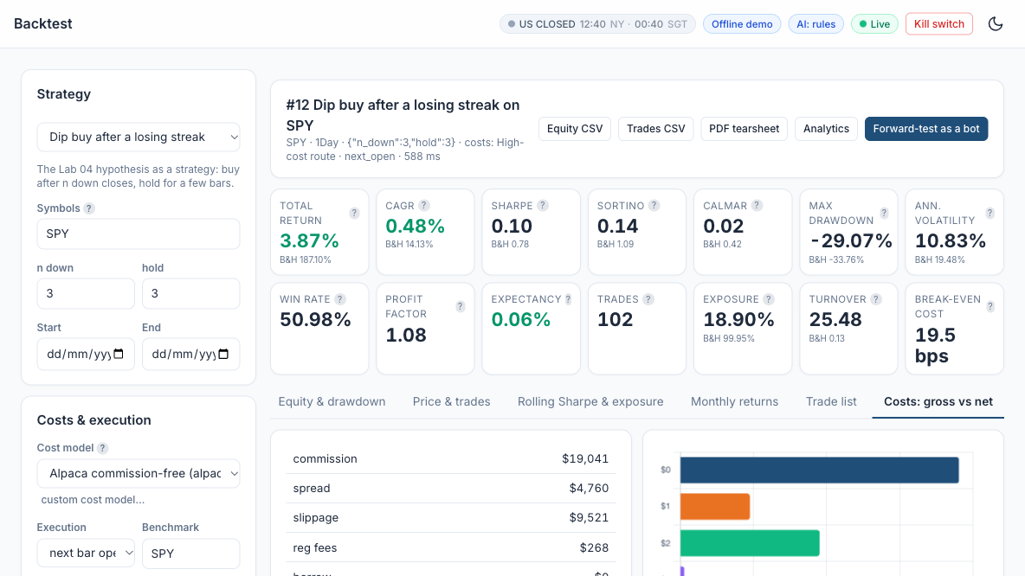
LAB 15 · SIMULATOR
Lab 15 — How to Read the Screen
Strategy
Dip buy after a losing streak (the Lab 04 idea): n down 3, hold 3.
1
1
Cost model and execution
Run it with zero, alpaca_retail and high_cost; then try next-bar close.
3
2
Net result (high-cost route)
CAGR 0.48% and Sharpe 0.10 vs SPY's 14.13% and 0.78: costs ate the edge.
4
3
Trades and break-even
102 trades, turnover 25.5; break-even only 19.5 bps one way - fragile.
2
4
5
Costs: gross vs net
The dollar drag by type: commission, spread, slippage and fees.
5
A frequent trader lives or dies by costs: compare the break-even bps with your broker's real cost.
AI Powered Quantitative Trading Fundamentals · C728 · v2.0
© Tertiary Infotech Academy Pte Ltd
197

Slide 198
TOPIC 4 · HANDS-ON LAB
Automation Stage: a Scheduled, Risk-Checked Forward Test and Live Paper Trading
LAB 16
Create a bot, run it on a schedule, watch orders, positions and P&L live, and halt it with the kill switch.
WORKFLOW
1
2
3
4
Simulator: Create the bot
▶
Simulator: Start it and watch
▶
Simulator: Kill switch
▶
Simulator: Backtest vs forward
YOU'LL PRODUCE
Duration
30 min
A bot equity curve, a blotter of its orders, a backtest-vs-forward comparison and a tested kill switch.
AI Powered Quantitative Trading Fundamentals · C728 · v2.0
© Tertiary Infotech Academy Pte Ltd
198

Slide 199
LAB 16 · FOLLOW ALONG
Lab 16 — Step by Step
Course Labs > Lab 16 at http://localhost:8000 - each step's Go button opens its page pre-filled. Tick each 'You should see' before moving on.
STEP · WHERE
DO THIS
YOU SHOULD SEE
Create the bot
▸ Paper Trading > New bot (EMA cross)
Paper Trading > + New bot: EMA crossover 10/30 on SPY, schedule 'every 10s', simulator broker, replay from 2025-01-02.
✓ The bot appears with status stopped.
1
Start it and watch
▸ Paper Trading > Bots
Press Start. Every cycle replays one trading day: it sees bars to yesterday's close and its orders fill at today's open. Or press 'Run one cycle now' repeatedly.
✓ Equity curve grows cycle by cycle; the Pipeline Map path lights up during each cycle.
2
Kill switch
▸ same page
Press the bot's Kill switch, then try 'Run one cycle now'. Release it. Try the global kill switch in the top bar too.
✓ Cycles report 'kill switch ON - no orders sent'; the Risk stage turns red on the Pipeline Map.
3
Backtest vs forward
▸ same page
Press Compare in 'Backtest vs forward test'.
✓ The curves track closely; you can explain the remaining gap (whole shares, fills, timing).
4
AI Powered Quantitative Trading Fundamentals · C728 · v2.0
© Tertiary Infotech Academy Pte Ltd
199

Slide 200
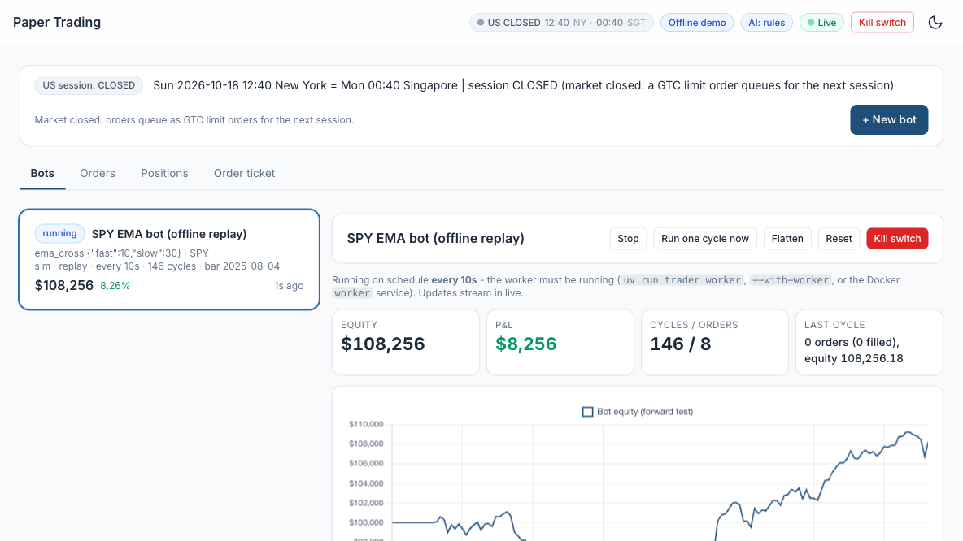
LAB 16 · SIMULATOR
Lab 16 — How to Read the Screen
Session and + New bot
EMA 10/30 on SPY, every 10s, simulator broker, replay from 2025-01-02.
1
1
Bot card
Status (running), strategy, schedule, cycles done and the current equity.
2
2
3
Controls
Stop, Run one cycle now, Flatten, Reset - and the red Kill switch.
3
4
Live numbers
Equity $108,256, P&L $8,256, 146 cycles / 8 orders, and the last cycle's result.
5
4
Forward-test equity
Grows one replayed trading day per cycle; compare it with the backtest.
5
With the kill switch ON, cycles send no orders - test it before you trust any bot.
AI Powered Quantitative Trading Fundamentals · C728 · v2.0
© Tertiary Infotech Academy Pte Ltd
200

Slide 201
TOPIC 4 · HANDS-ON LAB
Event-Driven Automation: TradingView Webhook to Signal, Risk and Execution
LAB 17
Send TradingView alerts to the app's webhook and see them pass validation, signal confirmation and risk into paper orders.
WORKFLOW
1
2
3
Simulator: Copy the alert template
▶
Simulator: Run the self-test
▶
Simulator: Real alerts (paid TradingView plan)
YOU'LL PRODUCE
Duration
25 min
7 simulated alerts handled as expected and the audit log.
AI Powered Quantitative Trading Fundamentals · C728 · v2.0
© Tertiary Infotech Academy Pte Ltd
201

Slide 202
LAB 17 · FOLLOW ALONG
Lab 17 — Step by Step
Course Labs > Lab 17 at http://localhost:8000 - each step's Go button opens its page pre-filled. Tick each 'You should see' before moving on.
STEP · WHERE
DO THIS
YOU SHOULD SEE
Copy the alert template
▸ Integrations > TradingView webhook
Open Integrations and scroll down to the TradingView webhook card. It holds the two things TradingView needs: where to send an alert (the Webhook URL) and what to send (the Alert message).
✓ You can say what each part of the message is for and which values TradingView fills in (the {{...}} placeholders).
1
Run the self-test
▸ System > Integrations
Press 'Run self-test (7 simulated alerts)'.
✓ 7/7 simulated alerts handled as expected: valid buy and sell (200), wrong secret (401), symbol not allowed and qty too large (422), malformed (400), retry ignored (200 duplicate).
2
Real alerts (paid TradingView plan)
▸ same page
Optional - trainer demonstration, or try it yourself if you have a paid TradingView plan. This is the same flow with a real TradingView alert.
✓ The alert appears in the audit log and its order in Paper Trading > Orders (source webhook).
3
AI Powered Quantitative Trading Fundamentals · C728 · v2.0
© Tertiary Infotech Academy Pte Ltd
202

Slide 203
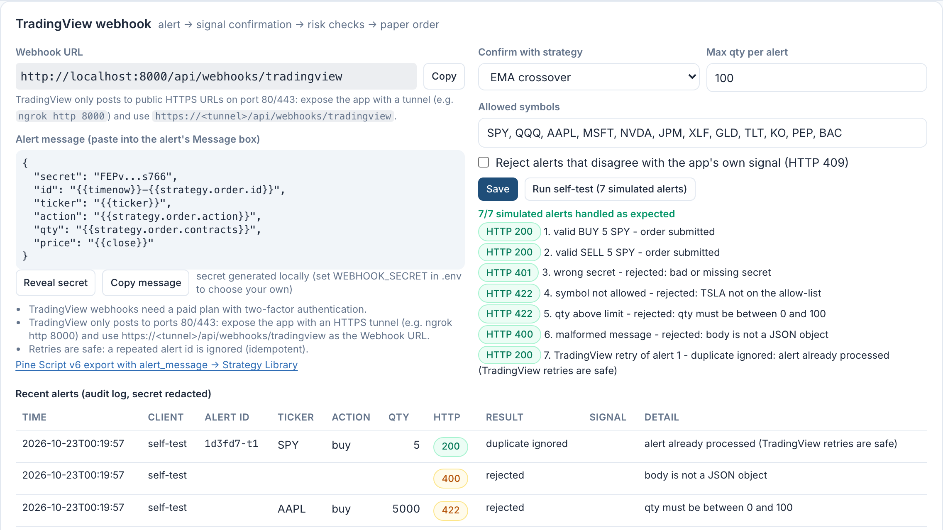
LAB 17 · SIMULATOR
Lab 17 — How to Read the Screen
1
The webhook path
alert -> signal confirmation -> risk checks -> paper order.
4
1
2
2
Webhook URL
Copy it. TradingView can only reach it through a public HTTPS tunnel (e.g. ngrok).
3
5
3
Alert message
The JSON for TradingView's Message box; its secret proves the alert is yours.
4
Confirm, cap and allow
Confirm with EMA crossover, max 100 per alert, listed symbols only.
6
5
Run self-test
7/7 handled: valid buy and sell 200, wrong secret 401, bad symbol or qty 422, malformed 400.
6
Audit log
Every alert with its HTTP code and result, secret redacted; a retry is 'duplicate ignored'.
Only alerts that pass the secret, signal and risk checks become paper orders - and a retried alert never trades twice.
AI Powered Quantitative Trading Fundamentals · C728 · v2.0
© Tertiary Infotech Academy Pte Ltd
203

Slide 204
TOPIC 4 · HANDS-ON LAB
Diagnostics Stage: Automated Bias Checks before Go-Live
LAB 18
Run the automated diagnostics on a deliberately biased strategy, fix it, and re-run.
WORKFLOW
1
2
3
Simulator: Diagnose the biased exhibit
▶
Simulator: Fix it in the Strategy Builder
▶
Simulator: Re-run diagnostics
YOU'LL PRODUCE
Duration
25 min
A FAIL on the biased exhibit, a PASS / WARN table for the fixed version and a verdict.
AI Powered Quantitative Trading Fundamentals · C728 · v2.0
© Tertiary Infotech Academy Pte Ltd
204

Slide 205
LAB 18 · FOLLOW ALONG
Lab 18 — Step by Step
Course Labs > Lab 18 at http://localhost:8000 - each step's Go button opens its page pre-filled. Tick each 'You should see' before moving on.
STEP · WHERE
DO THIS
YOU SHOULD SEE
Diagnose the biased exhibit
▸ Research > Diagnostics (Lab 18 exhibit)
Research > Diagnostics on 'Lab 18 exhibit: biased smoothed momentum' (seeded custom strategy).
✓ Look-ahead (features) FAIL: rolling(center=True) uses future bars. Verdict BLOCK.
1
Fix it in the Strategy Builder
▸ Strategy Builder (exhibit)
Open the exhibit in the Strategy Builder and change the single setting center=True to center=False (or let AI fix it: use the Lab 18 Strategy Builder prompt in the Prompt Library).
✓ The validation's look-ahead check now passes.
2
Re-run diagnostics
▸ Research > Diagnostics
Diagnose the fixed strategy; compare the same-bar vs next-bar Sharpe and the cost-drag row.
✓ No FAIL on look-ahead; cost drag and overfitting WARN explained.
3
AI Powered Quantitative Trading Fundamentals · C728 · v2.0
© Tertiary Infotech Academy Pte Ltd
205

Slide 206
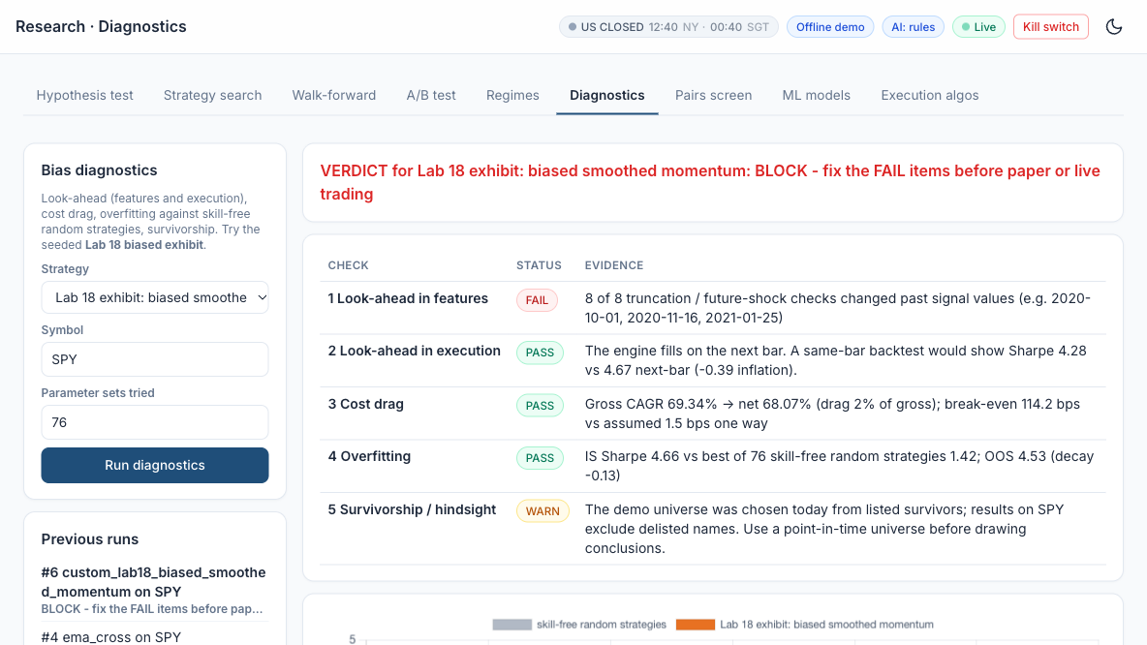
LAB 18 · SIMULATOR
Lab 18 — How to Read the Screen
Choose the exhibit
Lab 18 biased smoothed momentum on SPY; 76 parameter sets tried.
1
1
2
Verdict
BLOCK: fix every FAIL before paper or live trading.
2
3
Look-ahead in features: FAIL
rolling(center=True) peeks at future bars, so truncation changes past signals.
4
3
Execution, cost drag, overfitting
PASS: next-bar fills, small cost drag, beats 76 skill-free random strategies.
4
5
Survivorship: WARN
The universe is today's survivors - use a point-in-time universe.
5
Change center=True to center=False in the Strategy Builder, re-run, and the look-ahead FAIL becomes PASS.
AI Powered Quantitative Trading Fundamentals · C728 · v2.0
© Tertiary Infotech Academy Pte Ltd
206

Slide 207
TOPIC 4 · HANDS-ON LAB
Monitoring and Reporting Stage: Automated Tearsheet and Backtest-vs-Forward Report
LAB 19
Produce a one-page tearsheet and explain the gap between backtest and forward test.
WORKFLOW
1
2
3
Simulator: Export the tearsheet
▶
Simulator: Backtest vs forward
▶
Simulator: Draw insights
YOU'LL PRODUCE
Duration
30 min
A PDF tearsheet and a written explanation of the backtest-vs-forward differences.
AI Powered Quantitative Trading Fundamentals · C728 · v2.0
© Tertiary Infotech Academy Pte Ltd
207

Slide 208
LAB 19 · FOLLOW ALONG
Lab 19 — Step by Step
Course Labs > Lab 19 at http://localhost:8000 - each step's Go button opens its page pre-filled. Tick each 'You should see' before moving on.
STEP · WHERE
DO THIS
YOU SHOULD SEE
Export the tearsheet
▸ Analytics > PDF tearsheet
Backtest page (or Analytics) > PDF tearsheet for your best backtest; also export the equity and trades CSV.
✓ The PDF has equity vs benchmark, drawdown, monthly heatmap, metrics and the cost table.
1
Backtest vs forward
▸ Analytics
Analytics: select your Lab 16 bot under 'Bot (backtest vs forward)'.
✓ Explain every material gap (fills, sizing, costs, timing).
2
Draw insights
▸ same page
Monthly heatmap: in which regimes did the strategy earn its returns, what drove its drawdowns?
✓ Two or three insights, not just numbers.
3
AI Powered Quantitative Trading Fundamentals · C728 · v2.0
© Tertiary Infotech Academy Pte Ltd
208

Slide 209
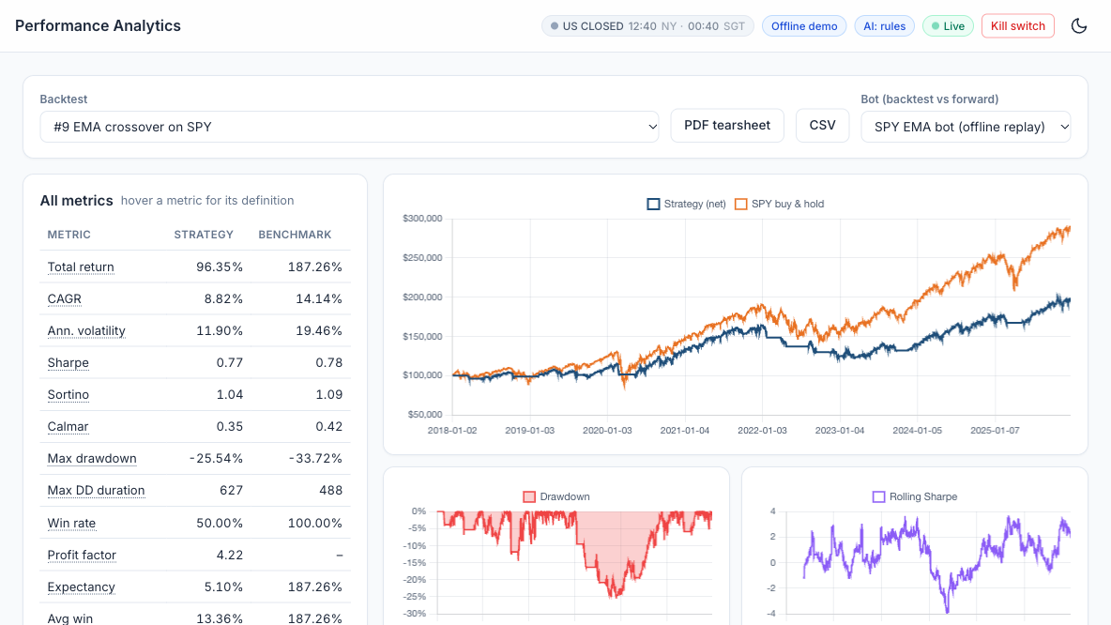
LAB 19 · SIMULATOR
Lab 19 — How to Read the Screen
Backtest and exports
Pick your best backtest; the PDF tearsheet and CSV go into the report.
1
1
2
Bot (backtest vs forward)
Select your Lab 16 bot to compare its forward test with the backtest.
3
4
2
All metrics
CAGR 8.82% vs 14.14%, Sharpe 0.77 vs 0.78, max drawdown -25.54% vs -33.72%.
3
Equity vs SPY
Flat stretches = out of the market; it falls behind SPY from 2022.
4
5
Drawdown
The 2022 bear market caused the deepest loss (about -25%).
5
A good report explains why: which regimes earned the returns and what drove the drawdowns.
AI Powered Quantitative Trading Fundamentals · C728 · v2.0
© Tertiary Infotech Academy Pte Ltd
209

Slide 210
TOPIC 4 · HANDS-ON LAB
Capstone: One Command Runs the Pipeline End to End, with an Agentic Layer and Human Approval
LAB 20
Run the whole pipeline end to end, get a human-approved proposal from the multi-agent desk, switch on the always-on agent, and create, backtest and forward-test your own strategy (from a template or written for you by AI).
WORKFLOW
1
2
3
4
5
Simulator: Run the multi-agent desk
▶
Simulator: Human approval
▶
Simulator: Always-on agent
▶
Simulator: Create your own strategy
▶
Simulator: Backtest, diagnose and forward-test it
YOU'LL PRODUCE
Duration
25 min
A Pipeline Map with every stage green, an approved agent proposal with its decision trace, and your custom strategy trading on paper.
AI Powered Quantitative Trading Fundamentals · C728 · v2.0
© Tertiary Infotech Academy Pte Ltd
210

Slide 211
LAB 20 · FOLLOW ALONG
Lab 20 — Step by Step
Course Labs > Lab 20 at http://localhost:8000 - each step's Go button opens its page pre-filled. Tick each 'You should see' before moving on.
STEP · WHERE
DO THIS
YOU SHOULD SEE
1
Run the multi-agent desk
▸ AI Agents > desk
AI Agents > Run multi-agent analysis on NVDA, AAPL, SPY.
✓ Eight agent entries per symbol plus the code gate; the brain badge shows which provider or rules answered.
2
Human approval
▸ AI Agents
Approve (or reject) the proposals. Approved buys become paper bracket orders in the regular session or extended-hours limit orders overnight.
✓ Run status 'executed' and the orders visible in Paper Trading (source agent).
3
Always-on agent
▸ same page
AI Agents > Always-on agent: enable it with a 60-minute wake-up (the worker must run), or press 'Wake it now'. Check Memory.
✓ A new always_on run and memory notes appear.
4
Create your own strategy
▸ Strategy Builder (EMA + RSI template)
Strategy Builder: start from a template and change only its parameters - or describe your idea in the Lab 20 prompt of the Prompt Library and paste.
✓ Your strategy appears in the Strategy Library with an auto-generated parameter form.
5
Backtest, diagnose and forward-test it
▸ Paper Trading > Bots
Backtest it, run Diagnostics, then create a paper bot for it and start it.
✓ Pipeline Map > Strategy lifecycle for your strategy shows the gates it passed.
6
End-to-end on the Pipeline Map
▸ Pipeline Map
Open the Pipeline Map and press 'Run a bot cycle'. Then switch to 'Strategy lifecycle'.
✓ All 14 stages have run; you can walk a colleague through each stage.
AI Powered Quantitative Trading Fundamentals · C728 · v2.0
© Tertiary Infotech Academy Pte Ltd
211

Slide 212
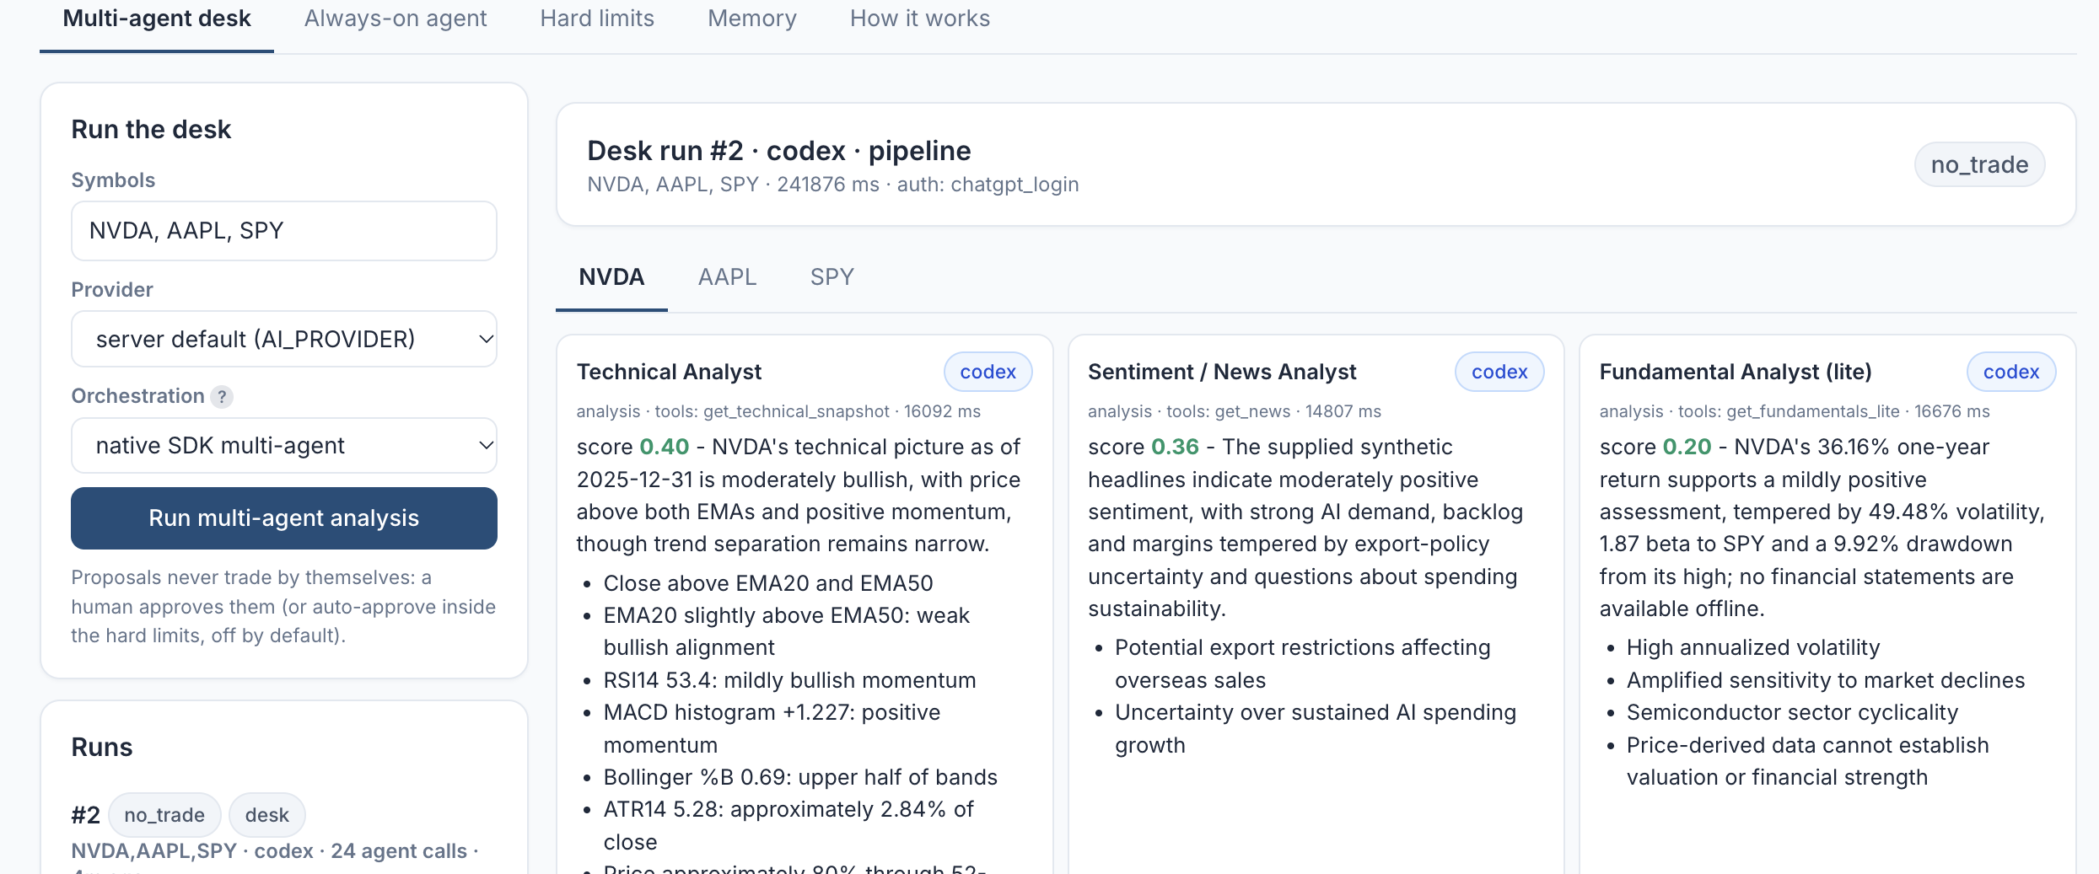
LAB 20 · SIMULATOR
Lab 20 — How to Read the Screen
Run the desk
NVDA, AAPL, SPY; pick the AI provider and orchestration, then Run.
1
1
3
Human approval
Proposals never trade by themselves - you approve or reject each one.
2
4
5
Run result
Desk run #2 by codex ended no_trade: the desk chose not to trade.
3
2
One tab per symbol
NVDA, AAPL and SPY each get their own analyst cards.
4
Analyst cards
Technical, sentiment and fundamental analysts each give a score and their reasons.
5
Then create your own strategy, backtest, diagnose and forward-test it, and walk the Pipeline Map end to end.
AI Powered Quantitative Trading Fundamentals · C728 · v2.0
© Tertiary Infotech Academy Pte Ltd
212

Slide 213
TOPIC 4 · WHAT YOU COVERED
Topic 4 Recap
1
Perform coding and configuration of software agents or programs based on selected models or algorithms
2
Conduct tests on the actions taken and outcomes to assess effectiveness of the models
3
Diagnose unintended outcomes produced by statistical models
4
Draw relevant trends and insights from data analysis to support decisions and report accordingly
5
Coding languages for programming of algorithms and signals
6
Potential reasons for unintended outcomes
AI Powered Quantitative Trading Fundamentals · C728 · v2.0
© Tertiary Infotech Academy Pte Ltd
213

Slide 214
SUMMARY
What You Achieved
Framed testable hypotheses
Instrument, signal, holding period, effect, benchmark.
Built indicators and strategies
Pine Script on TradingView; configured in the Trading Simulator.
1
2
Modelled and A/B-tested
ML classifiers, regimes, Welch's t-test and bootstrap.
Backtested net of costs
Commission, spread, slippage and regulatory fees.
3
4
Forward-tested automatically
A paper-trading bot with risk checks and a trade log.
Diagnosed and reported
Found the bias, fixed it, and wrote the recommendation.
5
✓
AI Powered Quantitative Trading Fundamentals · C728 · v2.0
© Tertiary Infotech Academy Pte Ltd
214

Slide 215
COURSE FEEDBACK
Before You Leave
Your materials
Slides, the Learner Guide and the lab manuals stay on the LMS and GitHub.
Course feedback
Complete the feedback form on the LMS.
1
2
Keep practising on paper
Your Alpaca paper account, the Trading Simulator and the lab manuals are yours to keep.
Not investment advice
Scenarios are fictitious; trade real money only with proper advice.
3
!
AI Powered Quantitative Trading Fundamentals · C728 · v2.0
© Tertiary Infotech Academy Pte Ltd
215

Slide 216
Thank You
AI Powered Quantitative Trading Fundamentals · C728
Tertiary Infotech Academy Pte Ltd · UEN 201200696W
AI Powered Quantitative Trading Fundamentals · C728 · v2.0
© Tertiary Infotech Academy Pte Ltd
216

